Slide 1
Matter and Change
Chapter 1

Slide 2
Section 1
Chemistry is a Physical Science

Slide 3
Objective:
Define Chemistry

Slide 4
What is Chemistry?
Chemistry is the study of the composition, structure, and properties of matter, the processes that matter undergoes, and the energy changes that accompany these processes

Slide 5
Let’s break that down:
1. Chemistry is the study of the composition, structure, and properties of matter
What does all that vocab even mean though?
Let’s look at the words composition, structure, properties, and matter together

Slide 6
Composition
What it is made of

Slide 7
Structure
Its arrangement (or what it looks like)

Slide 8
Properties
What does it do? Or
How does it act?

Slide 9
Matter
Anything that has mass and takes up space is matter
If it has any measurements (weight, length, etc.) it’s matter!
Everything in the universe is either matter or _____________. Do you know what else it could be?

Slide 10
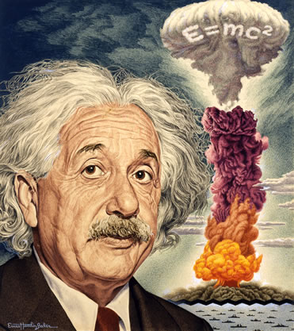
Matter or Energy!
What are the parts of his famous equation and what do they mean?

Slide 11
Second part of chemistry definition
2. The processes that matter undergoes
That means the stuff that matter does or the stuff that happens to matter

Slide 12
Third part of chemistry definition
3. The energy changes matter goes through
Matter either gains or loses energy with every change that happens to it
Terms for these energy changes are called endothermic and exothermic reactions (we’ll talk about them more later though)

Slide 13
Objective:
List examples of the branches (types) of chemistry

Slide 14
There are 6 main branches (types) of Chemistry
Organic Chemistry
Inorganic Chemistry
Physical Chemistry
Analytical Chemistry
Biochemistry
Theoretical Chemistry

Slide 15
Organic Chemistry
The study of chemicals and chemical reactions that contain carbon

Slide 16
Inorganic Chemistry
The study of non-organic chemistry
Non-organic means that it contains no carbon and does not belong to anything that is or once was living

Slide 17
Physical Chemistry
Studies the properties and changes of matter and the changes in energy associated with chemical reactions

Slide 18
Analytical Chemistry
Works to identify the composition of materials
What elements and chemicals are in this thing?

Slide 19
Biochemistry
The chemistry of and the chemical reactions involved with living things

Slide 20
Theoretical Chemistry
Uses math and computers to understand chemical reactions and predict future ones

Slide 21
Chemicals
In all types of chemistry, scientists use chemicals
A chemical is any substance that has definite composition
Definite means: uniform, regular, predictable, certain, static, stable

Slide 22
Objective:
Compare and contrast basic research, applied research, and technological development

Slide 23
Basic research
Done for the sake of increasing knowledge
Educational in purpose
Something we do just so we know about it better

Slide 24
Applied research
Done to solve a problem
It’s done for a specific purpose

Slide 25
Technological Development
Making things that make our lives better
Examples include computers, cars, biodegradable packaging, etc.

Slide 26
Check for Understanding:
1. Explain what chemistry is.
2. Name six branches of study in chemistry.
3. Compare and contrast basic research, applied research, and technological development.

Slide 27
Section 2
Matter and its properties

Slide 28
Objective:
Distinguish between the physical properties and chemical properties of matter

Slide 29
Vocab
Mass
Matter
Atom
Element
Compound
Extensive property
Intensive property
Physical property
Physical change

Slide 30
Mass
A measure of the amount of matter (stuff) in something

Slide 31
Matter
Anything that has mass and takes up space (has volume)

Slide 32
Atom
The smallest unit (part) of an element that maintains the identity of that element

Slide 33
Element
A pure substance that cannot be broken down into simpler stuff and is made of only one type of atom

Slide 34
Compound
A substance that can be broken down into simpler substances (elements).
Each compound is the combination of 2 or more elements.

Slide 35
Extensive property
They depend on the amount of matter (stuff) that is there.
Examples include volume, mass, and the amount of energy in a substance.

Slide 36
Intensive properties
They do not depend on the amount of matter (stuff) present.
They stay the same no matter how much or little you have of something.
Examples include melting point, boiling point, density, and ability to conduct electricity.

Slide 37
Physical property
A characteristic that can be observed or measured without changing the identity of the substance (without changing what it is)
Examples include melting point and boiling point. (the temperatures at which those things happen)

Slide 38
Objective:
Classify changes of matter as physical or chemical

Slide 39
Physical change
A change in something that does not involve a change in its identity
It’s when something is changed but even though that thing is different, it still is the same thing.
Examples include cutting, melting, and boiling

Slide 40
Objective:
Explain the gas, liquid, and solid states in terms of particles

Slide 41
States (Phases) of Matter
A change in state (or phase) of matter is a PHYSICAL change of a substance from one state (or phase) to another
The 3 common states of matter are solid, liquid, and gas

Slide 42
Solids
Solids have a definite volume (amount of space they take up) and a definite shape

Slide 43
Liquids
Liquids have a definite volume (amount of space they take up) but an indefinite shape (it changes).

Slide 44
Gas
Matter in the gas state has indefinite shape and volume (it could take up any amount of space and could be any shape).

Slide 45
Other states of matter?
Plasma is a very high energy state of matter (temperatures above gas) in which atoms lose their electrons
An example of plasma is fluorescent lights

Slide 46
Chemical Property
Relates to a substance’s ability to change into different substances
Chemical properties are all about how likely a substance is to react with other things, or what happens when they do react with each other

Slide 47
Chemical Change
Also known as a chemical reaction
When one or more substances are changed into a different substance
The stuff that goes into a chemical change/reaction is/are the reactant or reactants
The stuff that comes out of a chemical change/reaction is/are the product or products

Slide 48
Again…
What goes into a chemical reaction = Reactants
What comes out of a chemical reaction = Products
Remember these!

Slide 49
Conservation of Energy
Says that in a chemical reaction, the amount of energy that goes in must come out
An example is if you burn a piece of wood, the energy of the sun captured by the plant that made it grow is now released as heat, light, sound, etc. when the wood is burned.

Slide 50
Mixture
A blend of two or more kinds of matter, each of which retains its own identity and properties
It’s still easy to separate, and nothing new was made (there were no chemical reactions)

Slide 51
Homogenous Mixtures
Are the same in all parts of the sample. Example: salt water

Slide 52
Heterogeneous Mixtures
Are not the same in all parts of the sample. Example: a granite countertop

Slide 53
Pure substance
Have fixed composition (they’re always made up of the same stuff, they’re always homogeneous)
Every sample has exactly the same properties (the way it acts)
Every sample has exactly the same composition (what it’s made of)

Slide 54
Section 3
Elements

Slide 55
Objective
Describe the arrangement of the periodic table

Slide 56
Groups (or families)
The vertical (up and down) columns on the periodic table are called groups (or families)

Slide 57
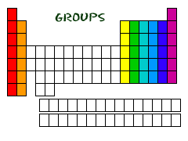

Slide 58
Periods
The horizontal rows of elements in the periodic table are called periods.

Slide 59
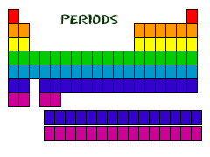

Slide 60
Objective
List the characteristics that distinguish metals, nonmetals, and metalloids.

Slide 61
Metals, nonmetals, metalloids
A metal is an element that is a good electrical conductor and a good heat conductor
This means that electricity and heat go through metals easily
Nonmetals are the opposite: it’s hard for electricity and heat to go through them
Metalloids are in between metals and nonmetals, in the middle.

Slide 62
