Slide 1
Chapter 2
Measurements and calculations

Slide 2
Section 1: Scientific method
Vocabulary you need to know:
Scientific method
System
Hypothesis
Model
Theory

Slide 3
Scientific method
The scientific method is a logical approach to solving problems by observing and collecting data, formulating hypotheses, testing hypotheses, and formulating theories that are supported by data.

Slide 4
Qualitative and quantitative observations
Observations may be descriptive without numbers (qualitative) or may use numbers (a quantity) to describe the observation (quantitative).
It’s easy! If the observation has numbers it’s quantitative, if it doesn’t it’s qualitative
What kind is better for science class? What gives you more accurate information? What type gives the same information to everyone that reads the observation?

Slide 5
system
A system is a specific portion of matter in a given region of space that has been selected for study during an experiment or observation.
All the materials that you are using to perform your experiment make up a system.
For example, all the beakers, test tubes, graduated cylinders, flasks, and chemicals you may be using for a lab make up a system.

Slide 6
Hypothesis
Scientists use generalizations about the data to formulate a hypothesis, or testable statement.
Most science teachers would say that a good hypothesis is an “if/then” or “if/then/because” statement.
For example, “If we give plants more water, then they will grow taller, because plants need water to grow.”
A good hypothesis must be testable! Is my example testable?

Slide 7
model
A model in science is more than a physical object, it is often an explanation of how phenomena (stuff that happens) occur and how data or events are related.
For example, a climate science model may show how all the inputs (stuff that happens) to a climate system affect it’s output (the conditions of the climate).

Slide 8
Section 2: Units of measurement
Objectives for this section:
Name and use SI units for length, mass, time, volume, and density
Distinguish between mass and weight
Perform density calculations

Slide 9
Key terms you need to know
Quantity
SI
Weight
Volume
Density

Slide 10
quantity
a quantity is something that has magnitude, size, or amount
How much stuff do you have? If you say a number, that’s a quantity
Quantities have to contain NUMBERS!

Slide 11
SI
Scientists all over the world have agreed on a single measurement system called Le Systeme International d’Unites, abbreviated SI
System International (or metric) units are what the rest of the world uses and what we use in science.

Slide 12
weight
Weight is a measure of the gravitational pull on matter
Do you remember what mass is?
How are mass and weight different?
It all has to do with GRAVITY. You could go anywhere in the solar system and have the same mass, but your weight would change depending on where you were.

Slide 13
volume
Volume is the amount of space occupied by an object

Slide 14
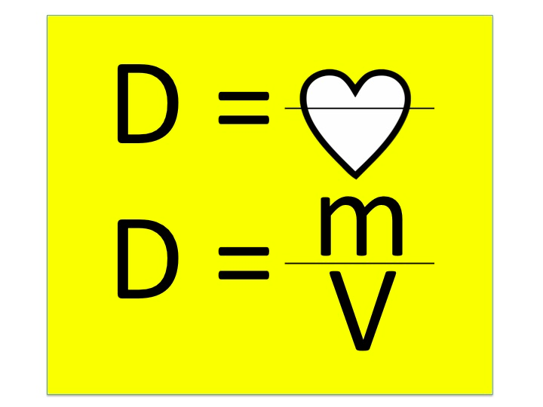
Density
Density is the ratio of mass to volume, or mass divided by volume

Slide 16
What do the parts of the magic triangle mean?
The m… the m stands for mass, and masses are given in grams (g)
The d... The d stands for density, and densities are given in grams/cubic centimeter (g/cm³) or grams/milliliter (g/ml)
The v... The v stands for volume, and volumes are given in cubic centimeters (cm³) or milliliters (ml)

Slide 17
5 SI units you need to know
Length- meter
Mass- gram
Time- second
Volume- cubic centimeter
Density- grams per cubic centimeter (or grams per milliliter, a cubic centimeter and a milliliter are the same thing)

Slide 18
Section 3
Using Scientific Measurements

Slide 19
Section 3 Objectives
Distinguish between accuracy and precision
Distinguish between inversely and directly proportional relationships

Slide 20
Accuracy
Accuracy refers to the closeness of measurements to the correct or accepted value of the quantity measured.
In Mr. Saurer’s words: accurate values would all be kind of close to the correct answer, even if they’re not close to each other

Slide 21
Precision
Precision refers to the closeness of a set of measurements of the same quantity made in the same way.
In Mr. Saurer’s words: precies values would all be kind of close to each other, even if they’re not close to the correct answer (the opposite of accuracy)

Slide 22
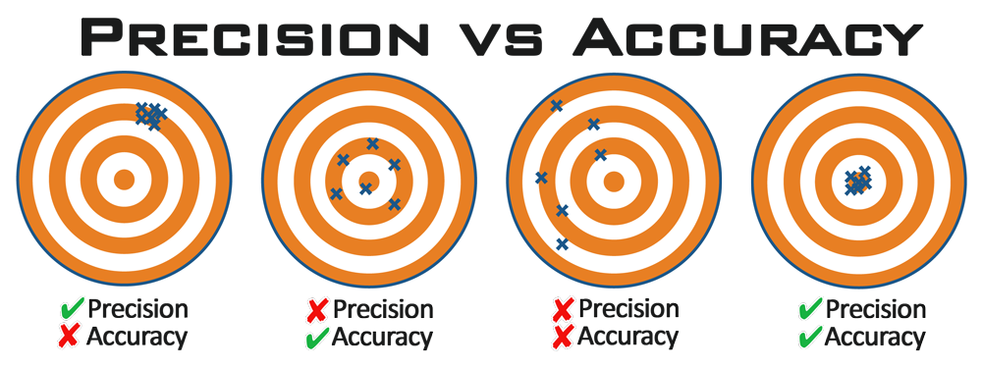

Slide 23
Directly vs. Inversely Proportional
When you’re talking about whether or not things are proportional, you’re always comparing two different values or variables
Directly proportional means as one variable goes up, so does the other
Inversely proportional means as one variable goes up, the other goes down

Slide 24
