Slide 1
Chapter 4
Arrangement of Electrons in Atoms

Slide 2
Section 1 Objectives
Explain the relationship between speed, wavelength, and frequency of electromagnetic radiation
Discuss the dual wave-particle nature of light
Discuss the significance of the photoelectric effect and the line-emission spectrum of hydrogen to the development of the atomic model

Slide 3
Electromagnetic Radiation
Visible light is a kind of EM radiation, which is a form of energy that exhibits wavelike behavior as it travels.

Slide 4
Electromagnetic Spectrum
All forms of EM radiation combined form the EM spectrum

Slide 5
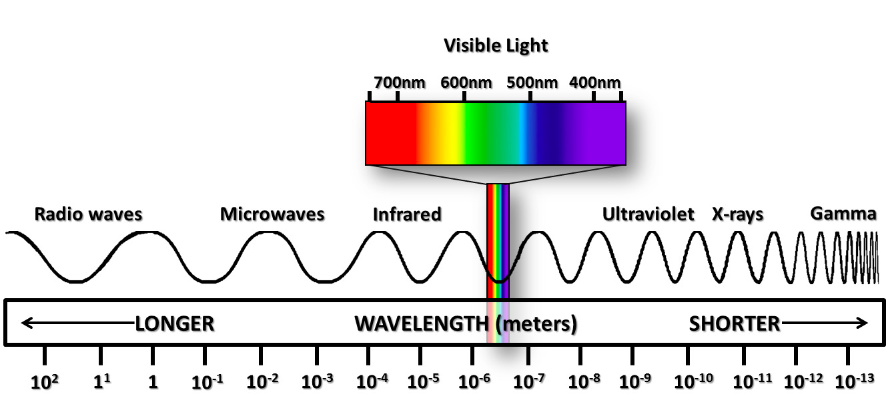

Slide 6
Wavelength
Wavelength is the distance between corresponding points on adjacent waves

Slide 7
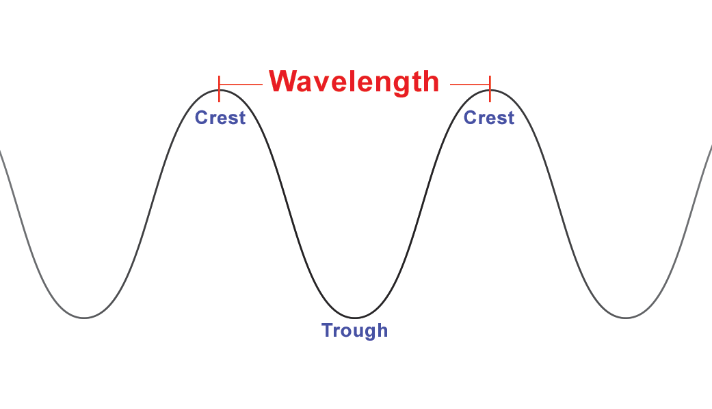

Slide 8
Frequency
Frequency is defined as the number of waves that pass a certain point in one second
Frequency is given in Hertz (Hz)
Example: 60 Hz is 60 whole waves per second

Slide 9
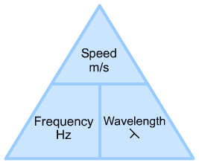
Speed-frequency-wavelength triangle

Slide 10
Speed-frequency-wavelength
Again, to find the third thing in the triangle just cover up whatever you’re looking for with your finger and then multiply or divide whatever is left
The speed of EM waves is the same
Frequency and wavelength are inversely proportional meaning as one goes up, the other goes down

Slide 11
Photoelectric effect
The prefix “photo” means light
The photoelectric effect describes the giving off of electrons from a metal (electricity) when light shines on the metal

Slide 12
Quantum
A quantum of energy is the minimum quantity (amount) of energy that can be lost or gained by an atom

Slide 13
Wave-particle nature of light
Einstein introduced the WP nature of light idea in 1905
Light has many wave-like properties
It also has many particle-like properties
Light acts as if it is both a wave and a particle of energy

Slide 14
Photon
A photon is a particle of EM radiation having zero mass but carrying a quantum (a certain amount) of energy
Photons are like little packets of light energy

Slide 15
Section 2 Objectives
Explain the Heisenberg Uncertainty Principle

Slide 16
Heisenberg Uncertainty Principle
This states that it is impossible to determine simultaneously both the position and velocity of an electron or any other particle

Slide 17
Quantum Theory
Quantum Theory describes mathematically the wave properties of electrons and other very small particles.

Slide 18
Emission spectrum
When you put electricity through a tube of gas, it gives off energy in the form of heat and light
Each element or mixture of elements makes a different color light
When you separate the light given off with a prism, the emission spectrum of that gas becomes apparent
The lines in the rainbow are the actual separate wavelengths (colors) of light given off, we just see the mixture

