Slide 1
Chapter 5
The Periodic Law

Slide 2
Section 1
History of the Periodic Table

Slide 3
Section 1 Objectives
Explain the roles of Mendeleev and Moseley in the development of the periodic table.
Describe the modern periodic table
Explain how the periodic law can be used to predict the properties of elements

Slide 4
Dmitri Mendeleev
Organized the first periodic table by using cards of the known elements and their properties set out on a table
He noticed that when the elements were arranged in order of increasing atomic mass, certain similarities in their properties appeared at regular intervals.
A repeating pattern like this is known as periodic

Slide 5
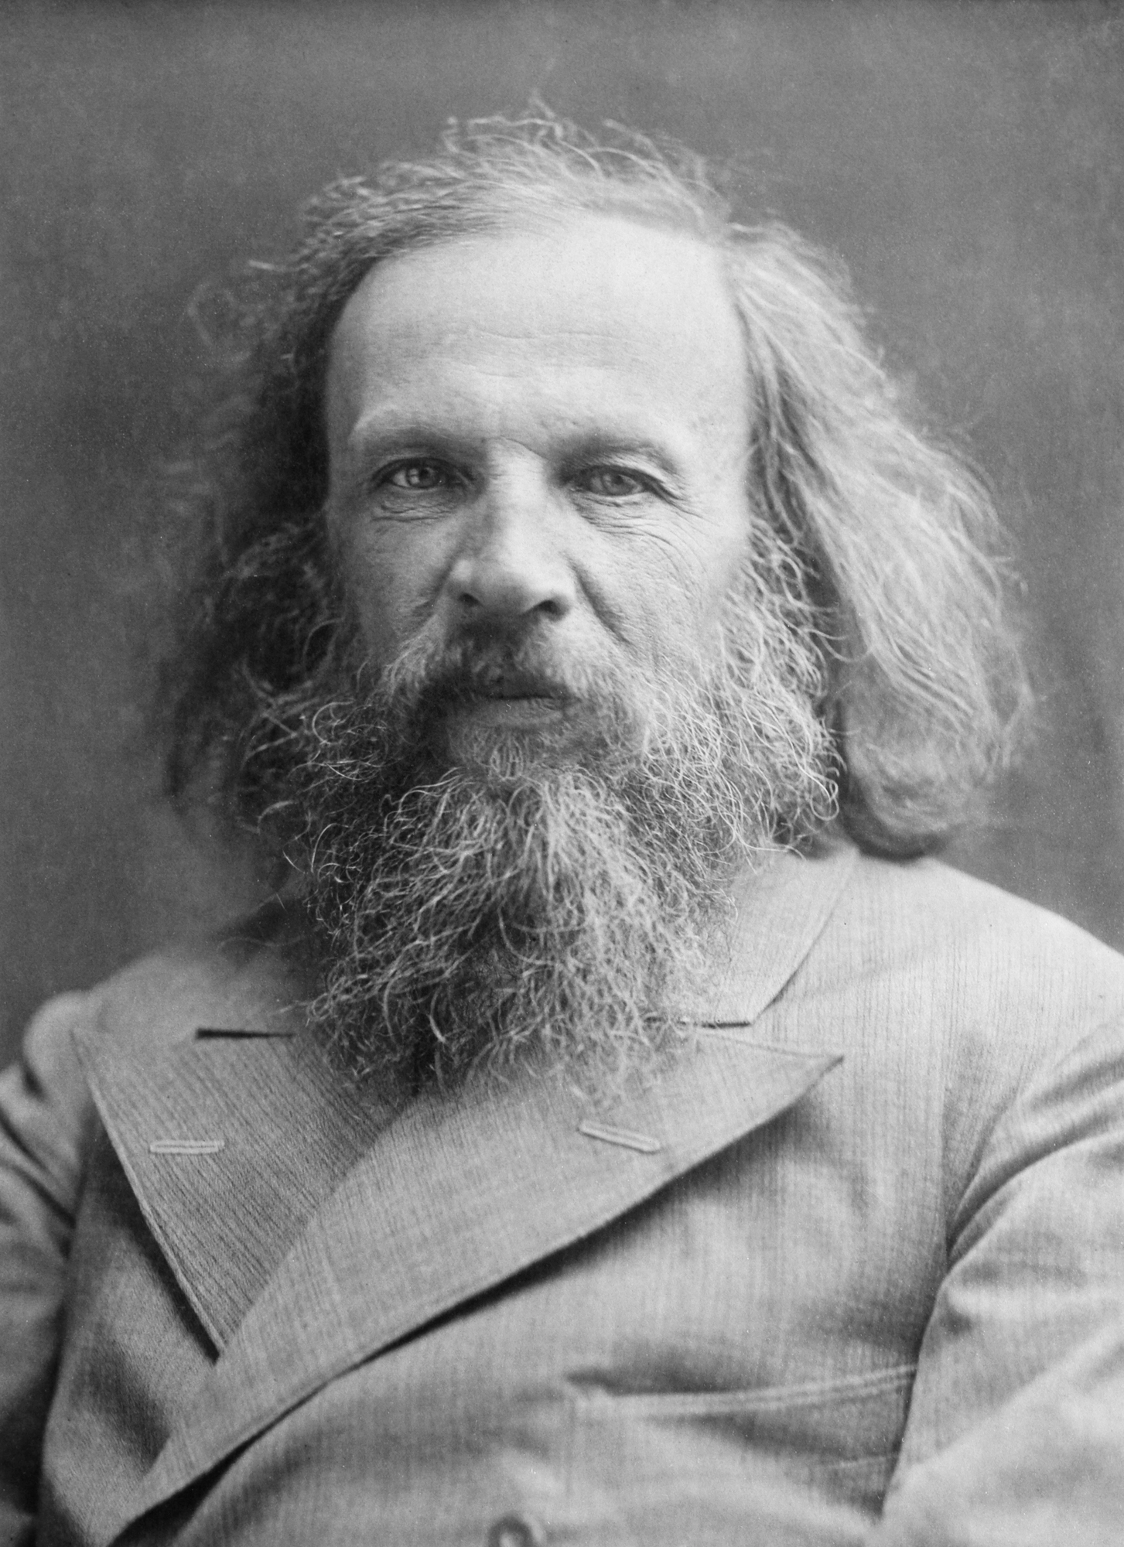
https://www.youtube.com/watch?v=IgA37CNa7Ow
https://www.youtube.com/watch?v=fPnwBITSmgU

Slide 6
After Mendeleev
Mendeleev’s Periodic Table was a great success but two questions remained:
1. Why could most of the elements be arranged in the order of increasing atomic mass, but a few could not?
2. What was the reason for chemical periodicity?

Slide 7
Henry Moseley
40 years after Mendeleev, Moseley noticed that the elements fit into the Periodic Table better when they were arranged in increasing order according to the number of protons in the nucleus.
Atomic number (protons) was more important than atomic mass (protons+neutrons)

Slide 8
Periodic Law
The physical and chemical properties of the elements are periodic (repeating) functions of their atomic numbers

Slide 9
Periodic Table
An arrangement of the elements in order of their atomic numbers so that elements with similar properties fall in the same column, or group.

Slide 10
Noble Gases
Group (column) 18, they have no chemical reactivity. Why?
Have a full electron “shell”
Called noble gases because they’re like nobility, too cool to hang out with the riff-raff (all the other elements)

Slide 11
Lanthanides
The 14 elements with atomic numbers from 58 to 71
They pretty much act the same chemically

Slide 12
Actinides
The 14 elements with atomic numbers from 90 to 103
They pretty much act the same chemically

Slide 13
Section 2 Objectives
Discuss the relationship between group electron configurations and group numbers
Describe the locations in the periodic table and the general properties of the alkali metals, the alkaline-earth metals, the halogens, and the noble gases.

Slide 14
What does group number tell you?
The group number (1,2, etc.) tells you how many valence (or extra) electrons an atom has. Atoms always want to have a full outer “shell” (or orbit, or ring) of electrons and will take on or give up extra electrons to accomplish this.
Group number = number of extra electrons

Slide 15
Group 1, the alkali metals
The elements going down the left side of the P.T. in group 1 are known as the alkalis

Slide 16
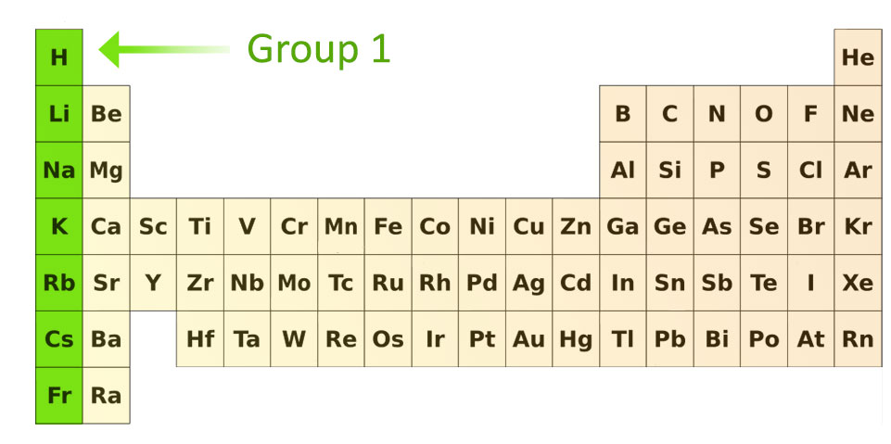

Slide 17
Alkali
All have one extra electron they’re trying to get rid of
They’re very reactive
They’re all silvery and soft enough to cut with a knife
Not found in nature though because they’re so reactive
Are usually stored in kerosene to keep them from reacting with the air or water

Slide 18
Group 2, the alkaline-earth metals
All have 2 extra electrons
Harder, denser, stronger than alkalis
Higher melting points than the alkalis
Not as reactive as Group 1, but still too reactive to be found in nature because they’ve all reacted with stuff

Slide 19
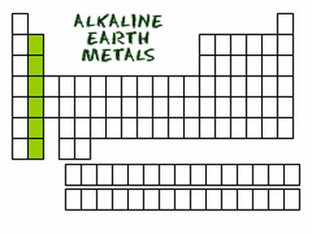

Slide 20
Group 7, the halogens
The halogens are the second to last column on the right of the PT
They’re all one electron short of a full outer shell or orbit of electrons
Just like the alkalis (with one extra electron) they are very, very reactive
Combine with metals to make salts

Slide 22
Group 8, the noble gases
Have full outermost layers so they don’t react with anything
All the way on the far right column of the Periodic Table

Slide 23
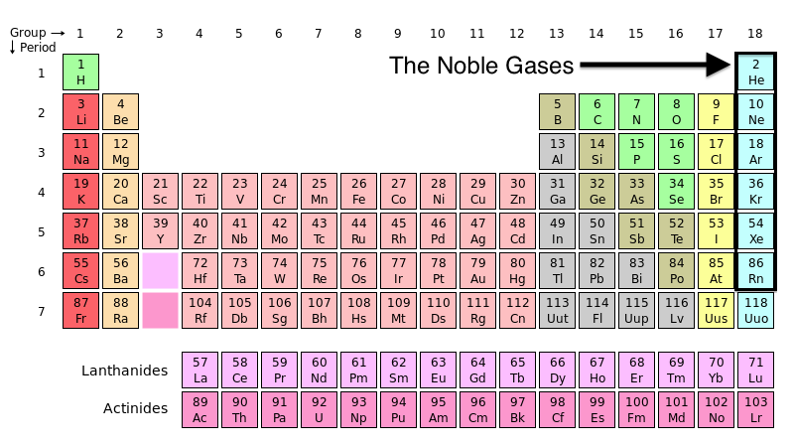

Slide 24
Section 3 Objectives
Define ionization energy and electronegativity
Define valence electrons, and state how many are present in atoms of each main-group element

Slide 25
Ions
An ion is a charged (positive or negative) atom of an element
It’s charged because it gained or lost electrons. If it gained electrons, it’s a negative ion. If it lost electrons, it’s a positive ion.

Slide 26
Ionization
Any process that results in the formation of an ion is referred to as ionization

Slide 27
Ionization Energy
Removing electrons from atoms to form ions requires energy
The energy required to remove one electron from an atom is called ionization energy
In general, ionization energies increase going from left to right in a period and decrease going down a group

Slide 28
Cations and anions
A positive ion is known as a cation
A negative ion is known as an anion

Slide 29
Valence electrons
The extra electrons available to be lost, gained, or shared in the formation of chemical compounds are referred to as valence electrons
Chemical reactions happen because of valence electrons. Without them, chemicals don’t react.

Slide 30
Electronegativity
Electronegativity is a measure of the ability of an atom in a chemical compound to attract electrons from another atom in the compound.
In general, electronegativity increases as you go from left to right across a period and decreases as you go down a group

