Slide 1
Chapters 6 and 7
Chemical Bonding
And
Chemical Formulas and Compounds

Slide 2
Chapter 6 section 1 Objectives
Define chemical bond
Explain why most atoms form chemical bonds
Differentiate between ionic and covalent bonding

Slide 3
Chemical Bond
A chemical bond is a mutual electrical attraction between the nuclei and valence electrons of different atoms that binds the atoms together
Why would the nucleus of one atom be attracted to the electrons of another?

Slide 4
Ionic bonding
Chemical bonding that results from the electrical attraction between cations and anions is called ionic bonding
In pure ionic bonding, atoms completely give up electrons to other atoms, leaving them with either a positive (cation) or negative (anion) charge

Slide 5
Covalent bonding
In contrast to ionic bonding, covalent bonds are form when electrons are shared between atoms, not given up or taken on
Covalent bonding results from the sharing of electron pairs between two atoms

Slide 6
Ionic or covalent?
Bonds between atoms are rarely all ionic or all covalent
Most bonds are a combination of both
You can estimate what kinds of bonds will form by figuring out the difference in the atoms’ electronegativities

Slide 7
Electronegativity and bonding
The bigger the difference in electronegativity between atoms, the more ionic their bonding is.
If atoms have a small difference in electronegativity, the more covalent their bond is.
So if two atoms from the far left and far right of the table meet, it’s ionic. Two atoms from the middle area of the table would be more covalent.

Slide 8
Section 2 objectives
Define molecule and molecular formula
State the octet rule
List the six basic steps used in writing Lewis structures

Slide 9
Molecule
A molecule is a neutral group of atoms that are held together by covalent bonds
A molecule can be multiple atoms of the same element or of different elements
A chemical compound whose simplest units are molecules is called a molecular compound

Slide 10
Chemical formula
A chemical formula indicates the relative numbers of atoms of each kind in a chemical compound by using atomic symbols and numerical subscripts
H₂0 is a chemical formula
H and O are symbols for elements Hydrogen and Oxygen
The little 2 means there are two Hydrogens

Slide 11
The octet rule
The prefix “oct” means 8, like an octagon. Don’t ask me about October, I know that doesn’t make any sense.
It just means that chemical bonds (ionic and covalent) form because atoms are trying to get closer to having 8 outermost electrons
They do this because they have less potential energy and are more stable there

Slide 12
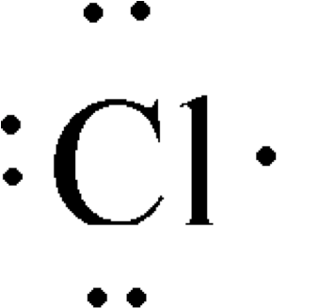
Electron-dot notation aka Lewis structures
Use dots drawn around the symbol of an element to represent how many extra or valence electrons that atom has.
This is really all the electron information you need, since this is why chemical reactions happen in the first place

Slide 13
Section 4 (we skipped 3)
Metallic Bonding
When metal atoms are together, all of their electrons are free to move anywhere in the group of metal atoms
Makes metals good conductors of heat and electricity, as well as malleable and ductile (explained in the next slides)

Slide 14
Malleability
The ability of a substance to be hammered or beaten into thin sheets

Slide 15
Ductility
The ability of a substance to be drawn, pulled, or extruded through a small opening to produce a wire

Slide 16
Chapter 7
Chemical Formulas and Chemical Compounds

Slide 17
Formulas
Formulas tell the number and kinds of atoms in a compound (a compound is a combination of atoms)

Slide 18
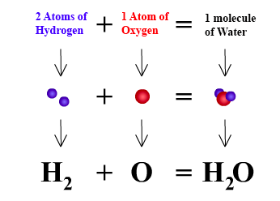

Slide 19
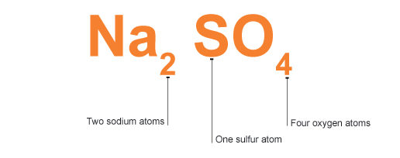

Slide 20
