Slide 1
Chlorofluorocarbons

Slide 2
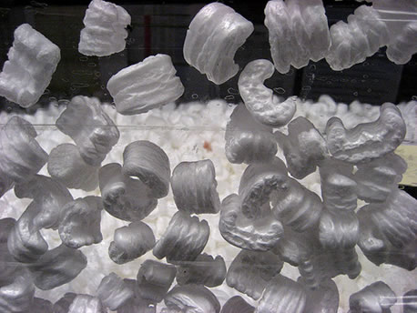
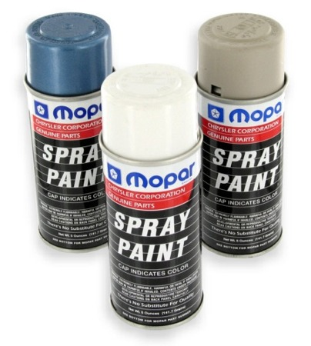
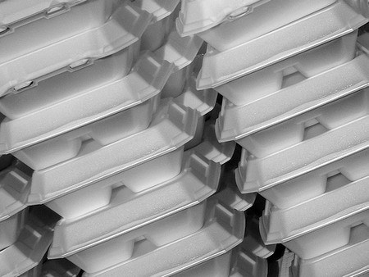
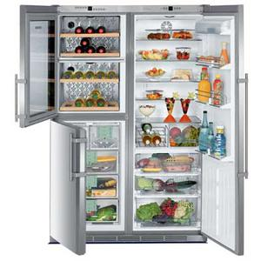
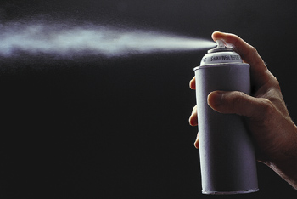
Products

Slide 3
Fredric Swarts
Early 1890s
Belgian chemist
Pioneer in synthesis of fluorinated alkanes
Generated effective fluorine exchange agent

Slide 4
Thomas Midgley Jr.
1930s
Synthesized dichlorofluoromethane using “Swarts process”
Demonstrated that dichlorofluoromethane was neither toxic nor flammable by inhaling vapors and blew out a candle

Slide 5
Common CFCs
trichlorofluoromethane
dichlorodifluoromethane
trichlorotrifluoroethane
dichlorotetrafluoroethane
chloropentafluoroethane

Slide 6
Before CFCs
Refrigerators used chemicals which were toxic or flammable or both
Since refrigerators were unsafe few people used them

Slide 7
CFCs
Highly stable compounds
Used as propellants in spray cans, refrigeration units, air conditioners, solvents and foam-blowing agents
Organic compounds of carbon, fluorine, chlorine and hydrogen
Manufactured under the trade name Freon

Slide 8
CFCs
Nontoxic
Nonflammable
Can be converted from a liquid to a gas and vice versa
Make styrofoam
Clean electronic equipment
Fire extinguishers

Slide 9
This all sounds too good to be true!
Lets add to that scientific history…
In the 1930’s equally important chemistry was being discovered concerning Earth’s atmosphere.

Slide 10
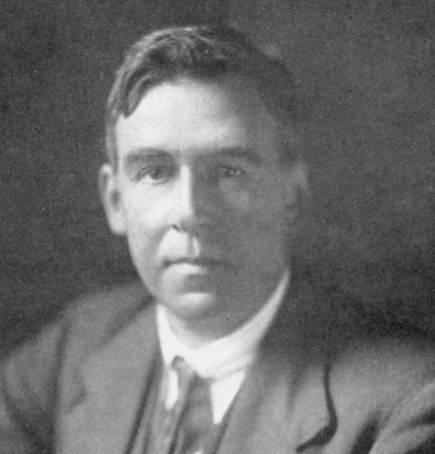
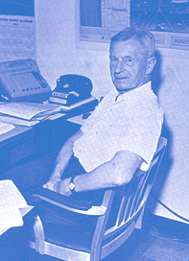
G.M.B. Dobson
Sidney Chapman
Both scientists that found and studied the ozone layer, what it does, and the processes that form it.

Slide 11
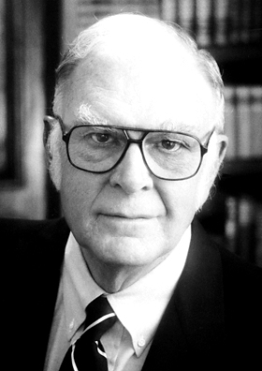
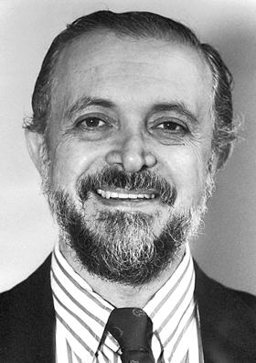
It wasn’t until the 1970’s that scientists found the problems of CFCs…
Frank Sherwood Rowland
Mario J. Molina
Won the Nobel Prize for Chemistry in 1995 with Paul J. Crutzen for their work on the formation and decomposition of ozone in the atmosphere.

Slide 12
Here’s what they found…
Hair
Spray
Notes:
Change background to a science lab or something

Slide 13
Hair
Spray
Hair
Spray
Hair
Spray
Notes:
Change background to a science lab or something

Slide 14
Hair
Spray
Notes:
Change background to a science lab or something

Slide 15
Notes:
Change background to a science lab or something

Slide 16
CFCl3 + electromagnetic radiation → CFCl2 + Cl
Notes:
Change background to a science lab or something

Slide 17
Notes:
Change background to a science lab or something

Slide 18
Notes:
Change background to a science lab or something

Slide 19
Notes:
Change background to a science lab or something

Slide 20
Notes:
Change background to a science lab or something

Slide 21
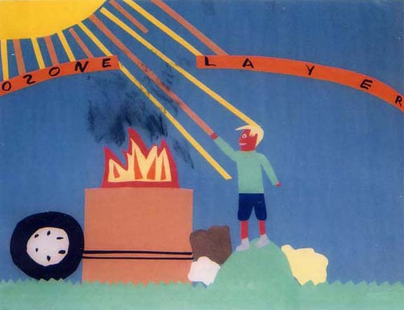
Ozone Depletion Who cares??
Ozone stops harmful light rays
This protects plants and animals from damage and death
“Twenty Questions and Answers About the Ozone Layer: 2006 Update”
D.W. Fahey Lead Author. June 2006
"Burn Barrels and Ozone Layer", St. Lawrence County NY EMC Poster Contest

Slide 22
How bad can it get?
Observations of low levels of ozone began in the 1980’s
The depletion at the south pole grows to be larger than Antarctica each year

Slide 23
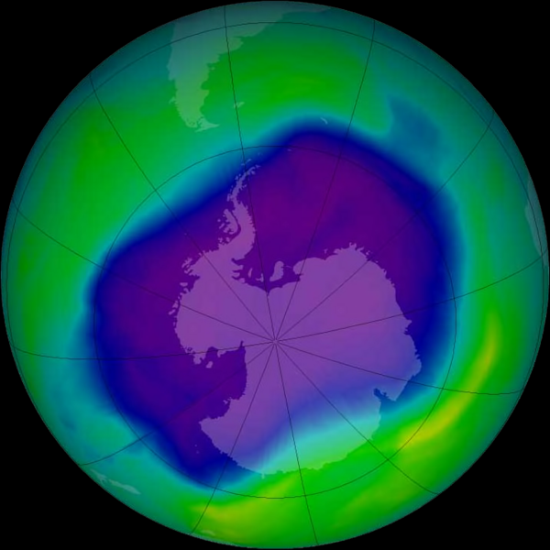
September 2006, the largest the ozone hole ever got

Slide 24
CFCs in the ’70’s
Use of CFCs rose every year until the possible link between Ozone depletion and CFCs was announced
People began to choose not to use as many CFCs after this

Slide 25
Proving the Connection
Doubt remained as to the connection between CFCs and the Ozone layer
In 1985 large amounts of ozone loss was reported
In 1989 the connection was proven

Slide 26
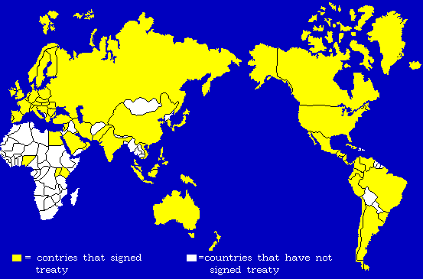
What could be done?
The Montreal Protocol was written and signed in 1987 to reduce CFC production and use
Nearly every country in the world has signed it
Calls to ban all CFCs
“Twenty Questions and Answers About the Ozone Layer: 2006 Update”
D.W. Fahey Lead Author. June 2006

Slide 27
In the USA
The US has met all of the goals set by the Montreal Protocol thus far
The US has developed and tested 300 alternative compounds

Slide 28
Alternatives to CFCs
HCFCs – can be broken down before they can destroy ozone

Slide 29
Did it work?
Total production of CFCs has decreased
The levels of CFCs in the atmosphere has decreased

Slide 30
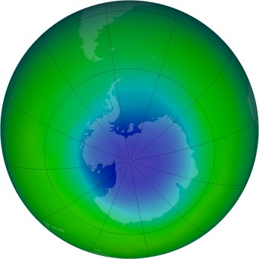
Did it work?
The Ozone hole is still very large
Repair will be complete around 2075

