Slide 1
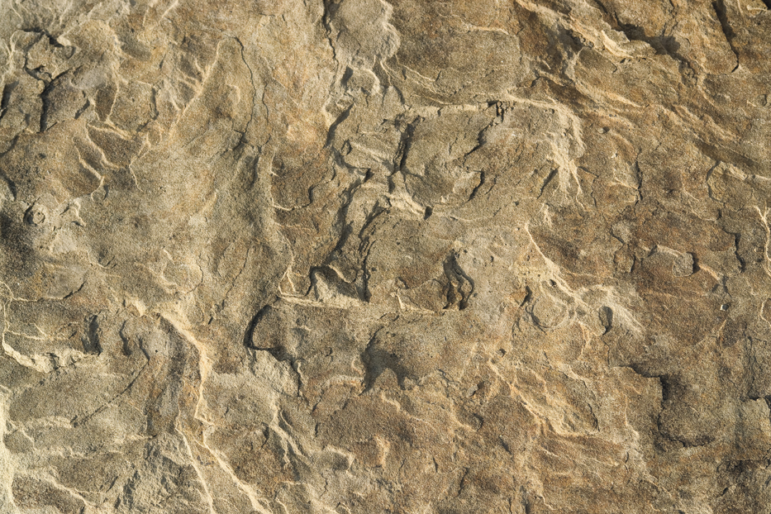
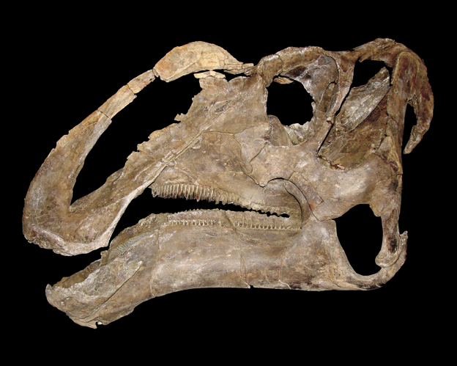
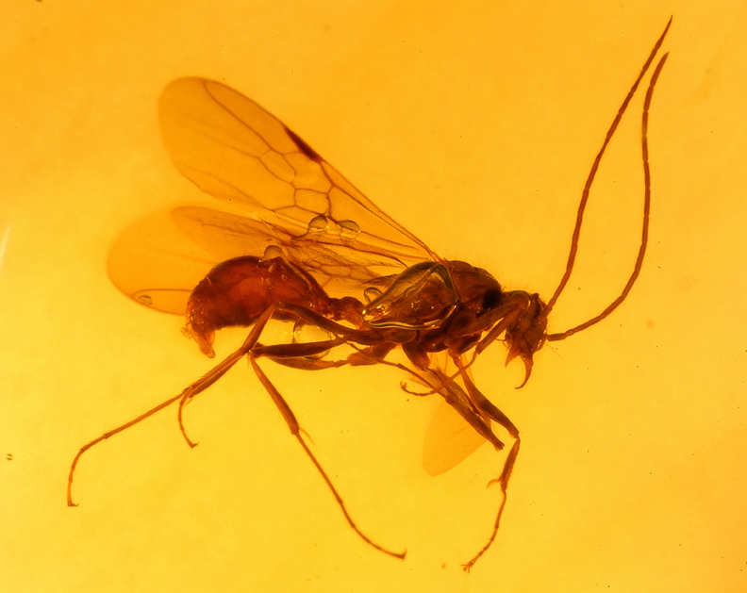

Slide 2
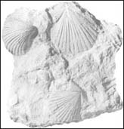
Is It a Fossil? Yes or No?

Slide 3
Fossils are the remains of living things.
They can be the remains of plants.
Fossil leaf

Slide 4
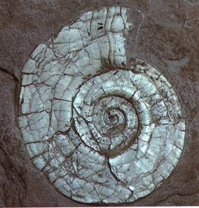
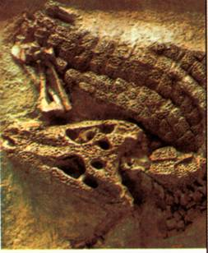
Or they can be the remains of animals. Animal fossils are usually shells or bones. The shells or bones are usually quite heavy, as they have been “turned into stone”. They are also usually a different color from when they were alive.
Fossil shell
Fossil alligator

Slide 5
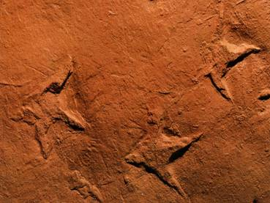
But do fossils have to be the actual remains of a living thing? The picture below shows the footprints of a snipe-like shore bird that lived among the dinosaurs about 100 million years ago. No bones of this bird are known to exist.
Do you think this is a fossil? Why or why not?
Bird footprints
Notes:
Have students brainstorm and respond to the question before continuing.

Slide 6
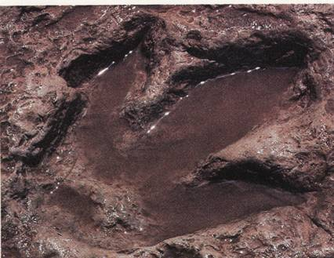
Fossil dinosaur footprint
Yes, the footprints are fossils. Fossils aren’t just the remains of living things. Fossils can be something that a living thing made.

Slide 7
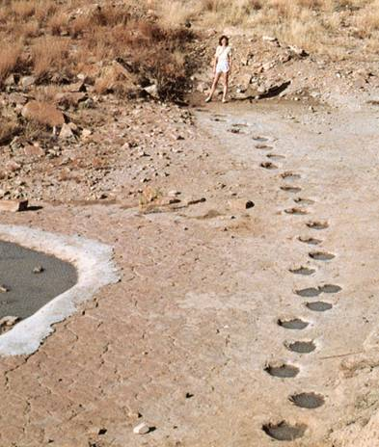
Footprints are not parts of a living thing. But they were made by living things.
Because they were made by living things, they are evidence that a living thing was there.
Fossil dinosaur tracks
Notes:
Ask students how the definition on the board could be modified to reflect this new information.
Write a revised definition on the board: Fossils are the remains or evidence of living things.

Slide 8
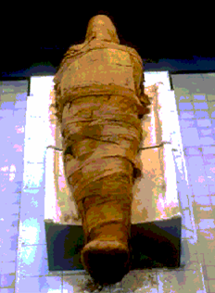
So, fossils are more than just the remains of living things. Fossils are the remains or evidence of living things.
This picture shows an Egyptian mummy.
Is the mummy the remains of a living thing?
Do you think the mummy is a fossil? Why or why not?
Egyptian mummy
Notes:
Have students brainstorm at each STOP sign and respond to the question before continuing.

Slide 9
No, an Egyptian mummy is not a fossil.
How was the mummy formed? Priests took the dead person’s body and cut out the internal organs, dried out the rest of the body with a chemical called natron, rubbed oils on the body and wrapped it in linen.
In other words, the mummy was made by man. That’s why the mummy isn’t a fossil. Fossils have to form naturally, without any help from man.
Egyptian mummy
Notes:
Ask students how the definition on the board could be modified to reflect this new information.
(Add that fossils are natural remains.)
Write a revised definition on the board: Fossils are the natural remains or evidence of living things.

Slide 10
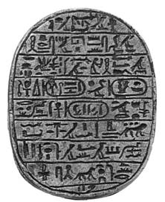
The Egyptian mummy isn’t a fossil for another reason. It’s not old enough. Fossils need to be at least 10,000 years old.
Fossils are prehistoric. Prehistoric means that it comes from a time before people could record their history. But Egyptians wrote about their lives using hieroglyphics.
Hieroglyphic writing
Because the mummy comes from a time when people were recording their history, the mummy is not prehistoric, so it isn’t a fossil. People started writing and recording their history about four to five thousand years ago.
Notes:
Ask students how the definition on the board could be modified to reflect this new information.
(Add that fossils are prehistoric.)
Write a revised definition on the board: Fossils are the natural remains or evidence of living things from prehistoric times.

Slide 11
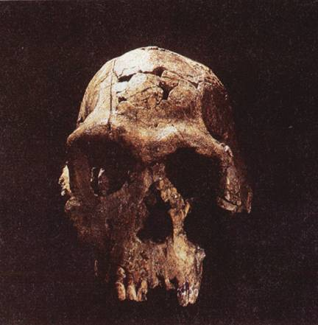
What about the bones of a cave man? Cave men drew pictures of animals on the walls of their caves.
Would the bones of a cave man be a fossil?
Cave man skull
Notes:
Have students brainstorm and respond to the question before continuing.

Slide 12
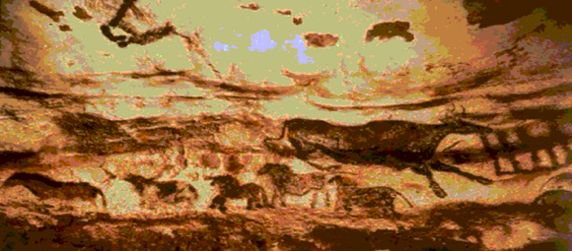
Cave paintings
Yes, the bones of a cave man would be a fossil. While the pictures cave men made show animals that lived at the time, the pictures don’t record the history of the cave men. Because people started writing their history about four to five thousand years ago, for something to be a fossil it has to be older than that.

Slide 13
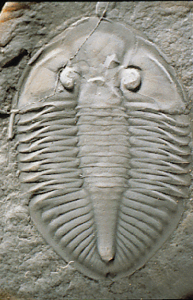
So, as fossil detectives, we now know exactly what kind of clues we’re looking for as we search for missing pages of the fossil diary.
Fossils are the natural remains or evidence of living things from prehistoric times.
Trilobite

Slide 14
What is a fossil?
A fossil is the preserved remains of a once-living organism. They are formed naturally.
What do fossils tell us?
Fossils give clues about organisms that lived long ago. They help to show that evolution has occurred.
They also provide evidence about how Earth’s surface has changed over time.
Fossils help scientists understand what past environments may have been like.

