Slide 1
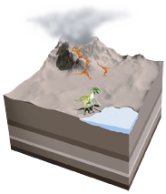
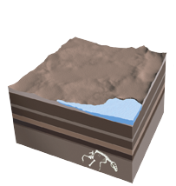
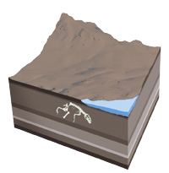
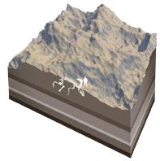
HOW IS A FOSSIL FORMED?
1. Sediment
An animal is buried by sediment, such as volcanic ash or silt, shortly after it dies. Its bones are protected from rotting by the layer of sediment.
2. Layers
More sediment layers accumulate above the animal’s remains, and minerals, such as silica (a compound of silicon and oxygen), slowly replace the calcium phosphate in the bones.
3. Movement
Movement of tectonic plates, or giant rock slabs that make up Earth’s surface, lifts up the sediments and pushes the fossil closer to the surface.
4. Erosion
Erosion from rain, rivers, and wind wears away the remaining rock layers. Eventually, erosion or people digging for fossils will expose the preserved remains.

Slide 2
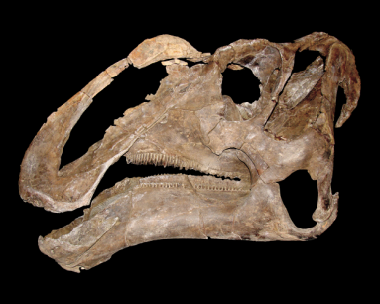
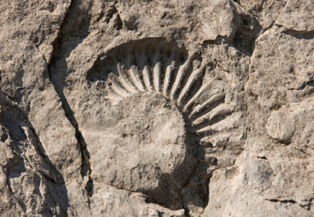
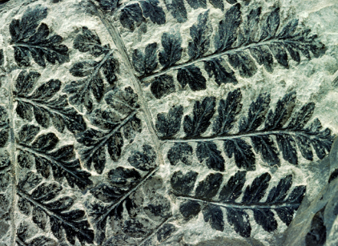
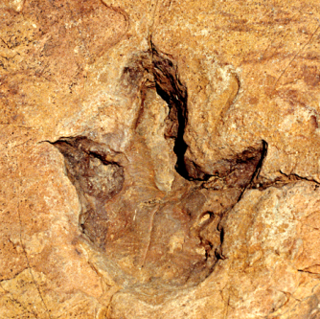
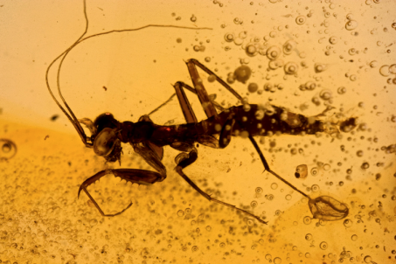
FIVE MAIN TYPES OF FOSSILS
Petrified
Fossils
Molds and
Casts
Carbon Films
Trace
Fossils
Preserved
Remains

Slide 3
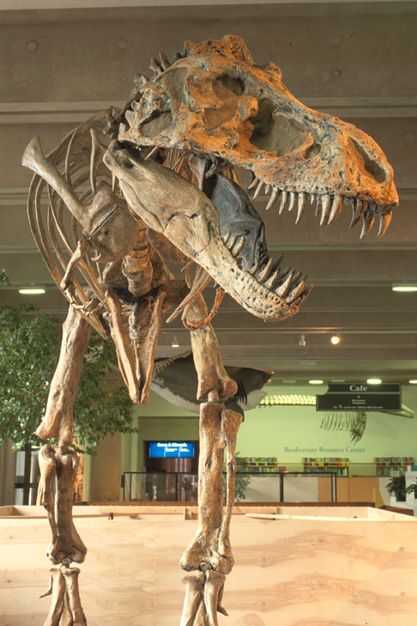
PETRIFIED FOSSILS
The word “petrified” means “turning into stone.”
Petrified fossils form when minerals replace all or part of an organism.
Water is full of dissolved minerals. It seeps through the layers of sediment to reach the dead organism. When the water evaporates, only the hardened minerals are left behind.
PETRIFIED FOSSIL The Field Museum in Chicago displays a fossil of a Tyrannosaurus rex.

Slide 4
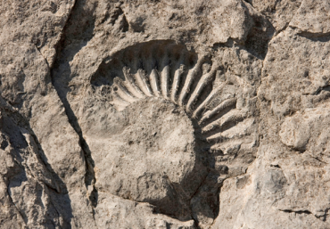
MOLDS AND CASTS
A mold forms when hard parts of an organism are buried in sediment, such as sand, silt, or clay.
The hard parts completely dissolve over time, leaving behind a hollow area with the organism’s shape.
MOLD FOSSIL
This mold, or imprint, is of an extinct mollusk called an ammonite.
A cast forms as the result of a mold.
Water with dissolved minerals and sediment fills the mold’s empty spaces.
Minerals and sediment that are left in the mold make a cast.
A cast is the opposite of its mold.
CAST FOSSIL This ammonite cast was discovered in the United Kingdom.

Slide 5
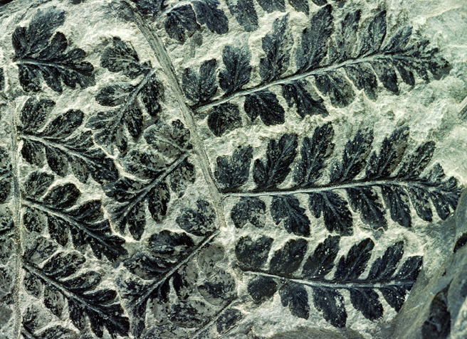
CARBON FILMS
All living things contain an element called carbon.
When an organism dies and is buried in sediment, the materials that make up the organism break down.
Eventually, only carbon remains.
The thin layer of carbon left behind can show an organism’s delicate parts, like leaves on a plant.
FERN FOSSIL This carbon-film fossil of a fern is more than 300 million years old.

Slide 6
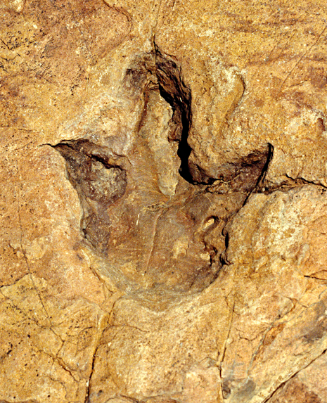
TRACE FOSSILS
Trace fossils show the activities of organisms.
An animal makes a footprint when it steps in sand or mud.
Over time the footprint is buried in layers of sediment. Then, the sediment becomes solid rock.
FANCY FOOTWORK This dinosaur footprint was found in Namibia, Africa.

Slide 7
More on trace fossils
Burrows or borings –
Spaces dug out by living things and preserved as is or filled in

Slide 8
More on trace fossils
Gastroliths – smooth stones from abdominal cavity of dinosaurs
Coprolites – fossilized excrement; usually preserved by replacement

Slide 9
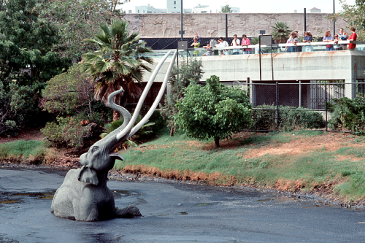
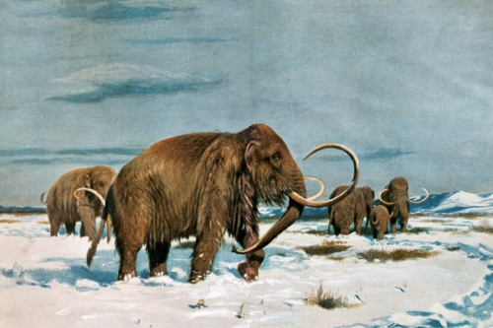
PRESERVED REMAINS
Some organisms get preserved in or close to their original states. Here are some ways that can happen.
Amber An organism, such as an insect, is trapped in a tree’s sticky resin and dies. More resin covers it, sealing the insect inside. It hardens into amber.
Tar An organism, such as a mammoth, is trapped in a tar pit and dies. The tar soaks into its bones and stops the bones from decaying.
Ice An organism, such as a woolly mammoth, dies in a very cold region. Its body is frozen in ice, which preserves the organism—even its hair!

Slide 10
What can the fossil record show us about life on Earth?
Asian Elephant
Wooly Mammoth
http://www.bbc.co.uk/radio4/science/frontiers_20020515.shtml
How are these two animals the same?
How are they different?
Notes:
(read from slide)
Have students compare the wooly mammoth and the Asian elephant. How are they alike and how do they differ. As a group you might want to create a Box & T-chart on the overhead, flipchart or whiteboard. Remind your students that the Box & T-chart is based upon observations only not inferences.
EXAMPLE Of BOX & T-CHART
Compare and Contrast with a Box and T-Chart
Large white tusks
Similarities Lump on head
Long, flexible trunks that touch the ground
Big body shape
Asian Elephant Wooly Mammoth
Short Hair Long hair
Differences Less curved tusks More curved tusks
No hump on back Large hump on back
Smaller ear flaps Larger ear flaps

Slide 11
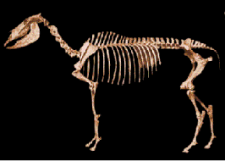
Once Upon a Time – A Look at the Horse
Horse B
Horse A
Notes:
Horse A is an example of an ancient horse. Over time Horse A evolved to look like Horse B, a modern day horse.
Background Information
Horse A - Hyracotherium – 55 million years ago (Eocene Epoch)
This small dog-sized animal represents the oldest known horse. It had a primitive short face, with eye sockets in the middle and a short diastema (the space between the front teeth and the cheek teeth). Although it has low-crowned teeth, we see the beginnings of the characteristic horse-like ridges on the molars. Hyracotherium is better known as "eohippus" - which means "the dawn horse." The name also refers to the fact that it lived during the Eocene.
Horse B - Equus – 5 million years Pliocene to Present
Equus is the only surviving genus in the once diverse family of horses. Domesticated about 3,000 years ago, the horse had a profound impact on human history in areas such as migration, farming, warfare, sport, communication, and travel. Species of Equus lived from 5 million years ago until the present. Living species include horses, asses, and zebras. Fossils of Equus are found on every continent except Australia and Antarctica.

Slide 12
Change Over Time – A Horse’s Foot
Note how the distance of the wrist bones from the ground changes. What else has changed?
wrist
Adapted from Florida Museum of Natural History. For more information visit their website at http://www.flmnh.ufl.edu/natsci/vertpaleo/fhc/relatives1.htm
Notes:
(Read slide to students)
What to look for:
Total length of foot
Number of toes making up the foot
The size of the hoof covering the foot

Slide 13
How have the bones in horse feet changed over time? Why might this have happened?
Let’s Look More Closely
Adapted from Florida Museum of Natural History. For more information visit their website at http://www.flmnh.ufl.edu/natsci/vertpaleo/fhc/relatives1.htm
Notes:
(Read the slide to the students)
BACKGROUND FOR THE TEACHER: The bones became longer and more streamlined, enabling horses to run faster to avoid predators.
The central toe of horses became increasingly stronger while the "side toes" became less important and are virtually lost in the modern horse.
Reduction and loss of side toes minimizes the weight at the extreme end of the foot. The horse's limb may move faster.
Changes:
Middle bone (toe) becomes more dominant
Side toes become virtually lost

Slide 14
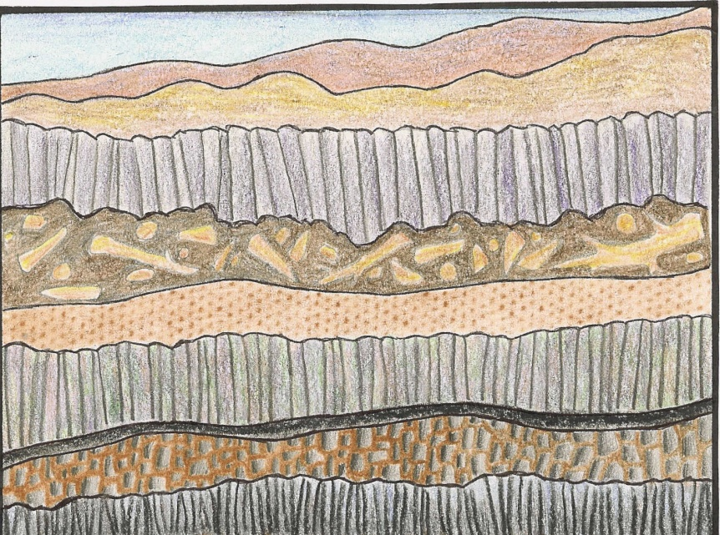
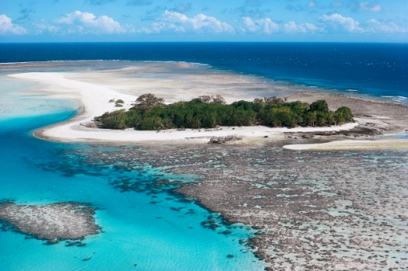
Wrap-Up
Fossils are formed under very special conditions.
They give us clues about what life was like long ago.
Fossils also give us clues about the environment from a long time ago.
They help us understand that plant and animal species change over time.
Notes:
(Read slide to students)

