Slide 1
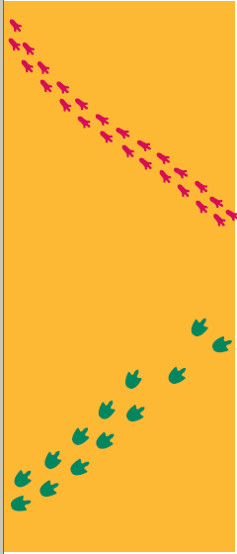
Look at these two sets of animal tracks.
List 3 OBSERVATIONS
Make an INFERENCE

Slide 2
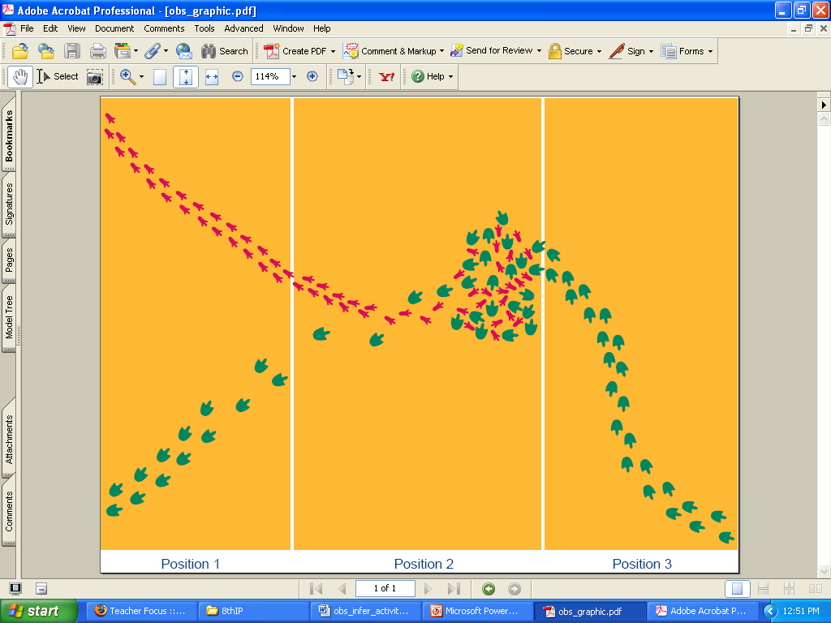
Now what do you think?
Make 3 OBSERVATIONS
Make an INFERENCE

Slide 3
Now what do you think?
Make 3 OBSERVATIONS
Make an INFERENCE

Slide 4
Observations
How we look at things in science

Slide 5
Observations
Use one or more of the 5 senses and/or measuring devices to gather information
A noting and recording of…. FACTS!!! (not opinions)
Example: There are two sinks in the room.

Slide 6
Two types of Observation
Qualitative
Quantitative

Slide 7
Qualitative Observations
Use the human senses to observe and describe things
Not great for science class because they leave some to the imagination (subjective)
Describes the qualities of something
  Color
  Taste
  Sound

Slide 8
Quantitative Observations
Can be expressed in numbers (a quantity)
Can be counted or measured
  Amounts
  Temperature
  Mass
  Length
Allow us to communicate specifics
Tools are used to communicate data

Slide 9
Inference
Logical interpretation based upon prior knowledge and experience (a connection you made in your head that isn’t necessarily factual)
Based upon observations
Practice:
Observations:
  I hear people screaming
  I smell cotton candy, popcorn, and hamburgers
  I see a lot of people
Inference = ?

Slide 10
Note the Difference
In laboratory exercises, record observations NOT inferences
Inferences may ONLY be used when writing the conclusion in your lab report.

Slide 11
Observation Inference
That plant is extremely wilted.
The car stopped running
The Diamondbacks are leading their division
That plant is extremely wilted due to a lack of water.
The car stopped running because it was out of gas.
The Diamondbacks are leading their division because they are playing well right now.

Slide 12
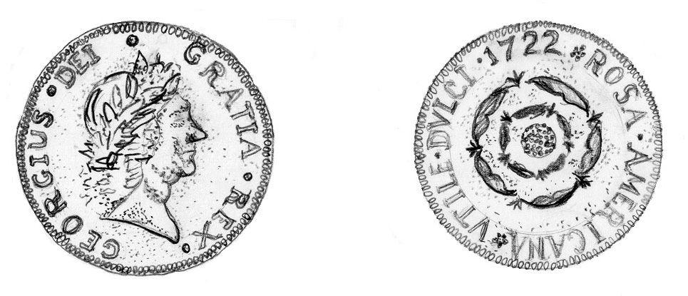
Observation or
Inference
There is a representation of a face on one side of the coin.
The Latin word "Dei" means "God.“
The coin was made by deeply religious people.
The date 1722 is printed on one side of the coin.
The coin was made in 1722.
The face on the coin is a representation of the nation's president.

Slide 13
Observation or
Inference
Let’s Practice….
Look at the picture & decide if the statement is an

Slide 14
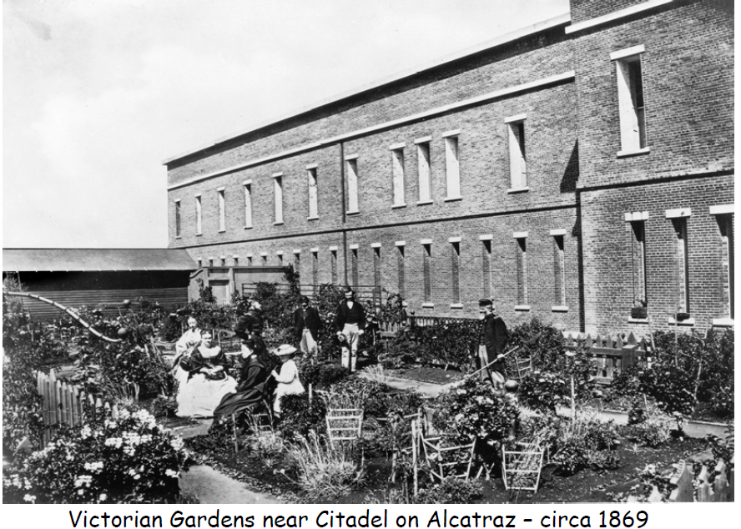
The narrow windows were used as rifle slits.
Inference

Slide 15
There was a garden located outside the Citadel.
Observation

Slide 16
Gardens were an important part of everyday life during the military years on Alcatraz Island.
Inference

Slide 17
People in the garden are in mourning.
Inference

Slide 18
Men were required to wear jackets and women were required to wear dresses
Inference

Slide 19
The citadel was made of brick.
Observation

Slide 20
There is a picket fence.
Observation

Slide 21
People used to spend more time outside.
Inference

Slide 22
There are eight people in the photograph.
Observation

Slide 23
The garden provided food for the families living on Alcatraz.
Inference

Slide 24
There are no cannons in this picture.
Observation

Slide 25
Look at these two sets of animal tracks.
List 3 OBSERVATIONS
Make an INFERENCE

Slide 26
Now what do you think?
Make 3 OBSERVATIONS
Make an INFERENCE

Slide 27
Now what do you think?
Make 3 OBSERVATIONS
Make an INFERENCE

Slide 28
When to use observation & inference…
During experiments, record observations NOT inferences
Inferences may only be used when writing the conclusion in your lab report.

