Slide 1
Weather & Climate Definitions
Weather- “the state of the atmosphere with respect to heat or cold, wetness or dryness, calm or storm, clearness or cloudiness”
Climate – “the average course or condition of the weather at a place usually over a period of years as exhibited by temperature, wind velocity, and precipitation”
For our class, weather is current atmospheric conditions and climate is average precipitation and temperature over at least a 30 year period

Slide 2
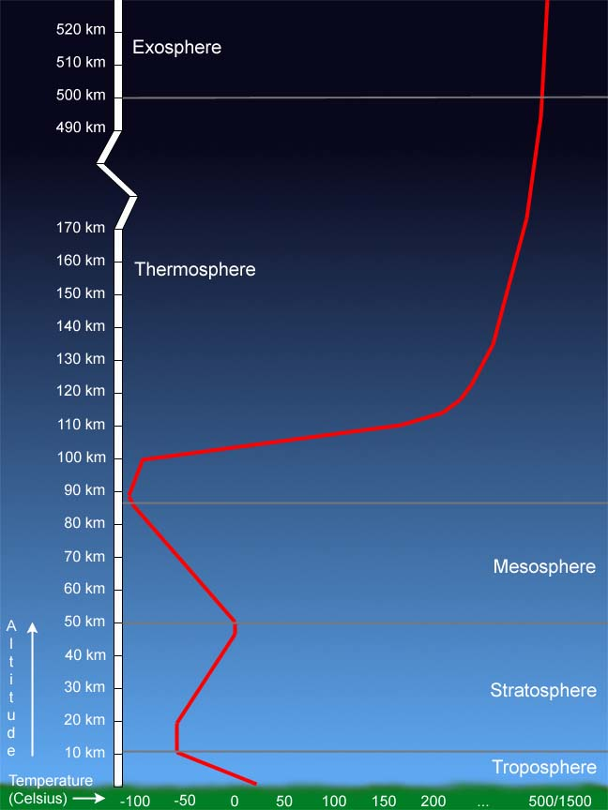
Atmosphere
Troposphere - Most of the weather
occurs.
Stratosphere - 19% of the atmosphere’s
gases are here; ozone layer is here
Mesosphere - Most meteorites burn up
here.
Thermosphere - High energy rays from
the sun are absorbed; hottest layer.
Exosphere - Molecules from atmosphere
escape into space; satellites orbit here.
Picture taken from:
http://www.windows.ucar.edu/tour/link=/earth/
Atmosphere/layers_activity_print.html

Slide 3
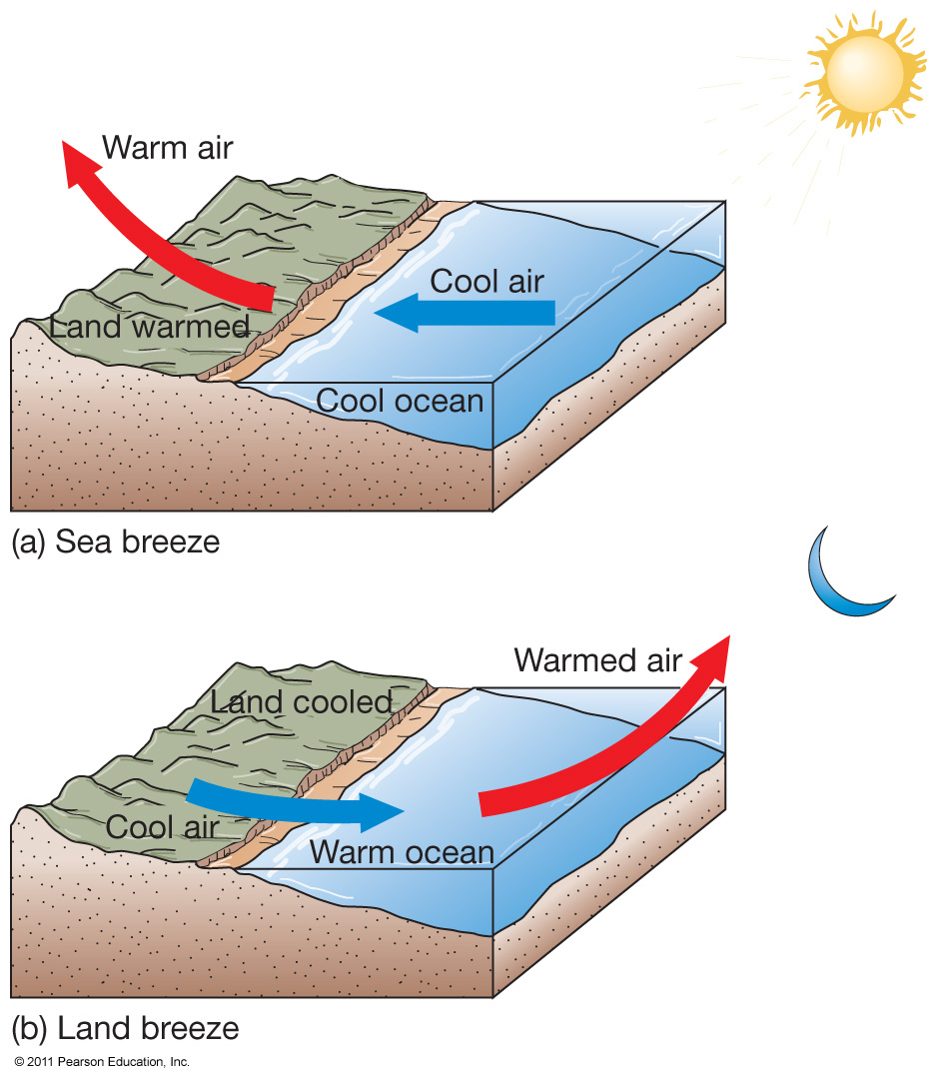
Sea and Land Breezes
Differential solar heating is due to different heat capacities of land
and water.
Sea breeze
  From ocean to land
Land breeze
  From land to ocean

Slide 4
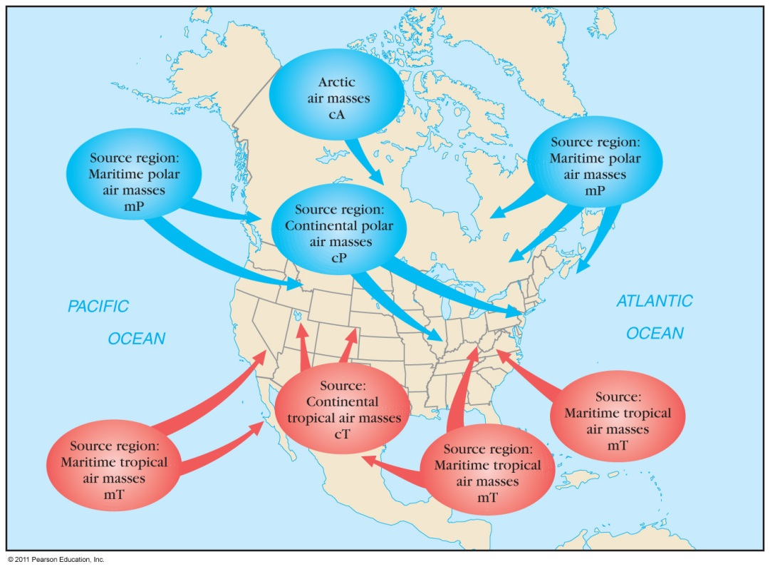
Storms and Air Masses
Storms – disturbances with strong winds and precipitation
Air masses – large volumes of air with distinct properties

Slide 5
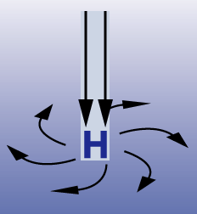
High Pressure
Higher pressure than what is
normal for that altitude.
What do you notice about the air in this region?
Brings clear skies and fair weather.
  The sinking cold air warms as it does so and becomes stable.
  Picture taken from:
  http://www.windows.ucar.edu/tour/link=/earth/Atmosphere/high_pressure.html

Slide 6
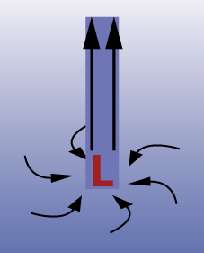
Low Pressure
  A low pressure region (depression
  or cyclone) is caused by rising air.
  Clouds, rain, and very strong winds
  occur.
  Why do you think that is?
  Picture taken from:
  http://www.windows.ucar.edu/tour/link=/earth/Atmosphere/low_pressure.html

Slide 7
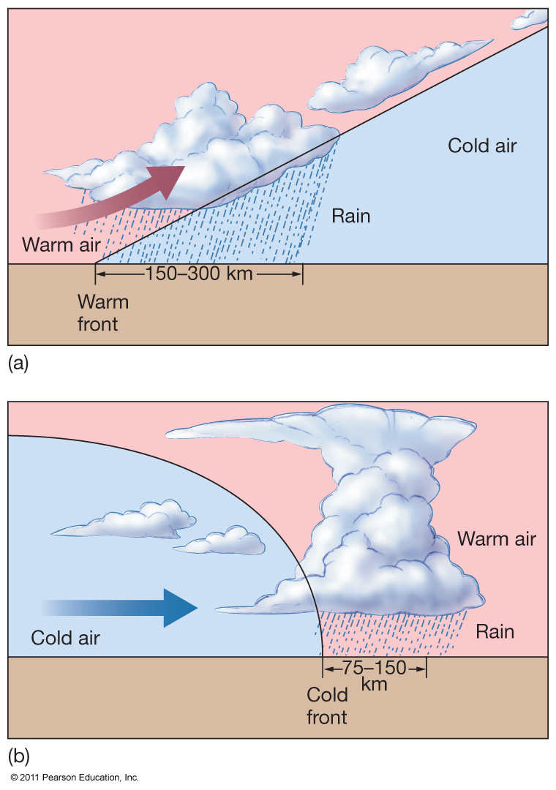
Fronts
Fronts – boundaries between air masses
  Warm front
  Cold front
Storms typically develop at fronts.
Jet Stream – may cause unusual weather by steering air masses.

Slide 8
Temperature & Humidity
Temperature - Air higher in pressure is usually cooler air and air lower in pressure is usually warmer air.
What happens when the two meet?
Humidity - How much water is in the air over how much water could fit in the air (right before the water begins to condense out of the air).
Dew point - Temperature at which the moisture saturates the air is the dew point.

Slide 9
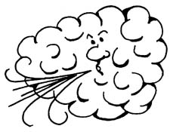
Wind
Caused by the earth’s surface
being heated unevenly by the sun.
Why would the earth’s surface heat unevenly?
How do you think this causes the wind?
Picture taken from:
http://www.disc.wisc.edu/pubs/Newsletters/feb03news.html

Slide 10
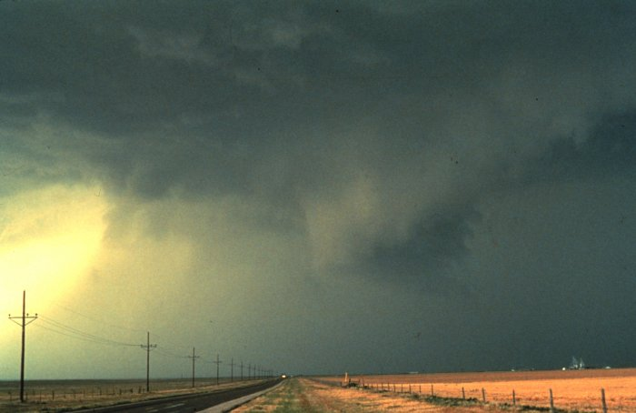
Thunderstorms
What type of cloud causes these?
Consists of gusty winds, heavy rain and hail.
Can result in a tornado
Picture taken from:
http://www.fairfield.k12.ct.us/Rogerludlowe/
crogerludlowe03/webquests/Weather/
thunderstorm.jpg

Slide 11
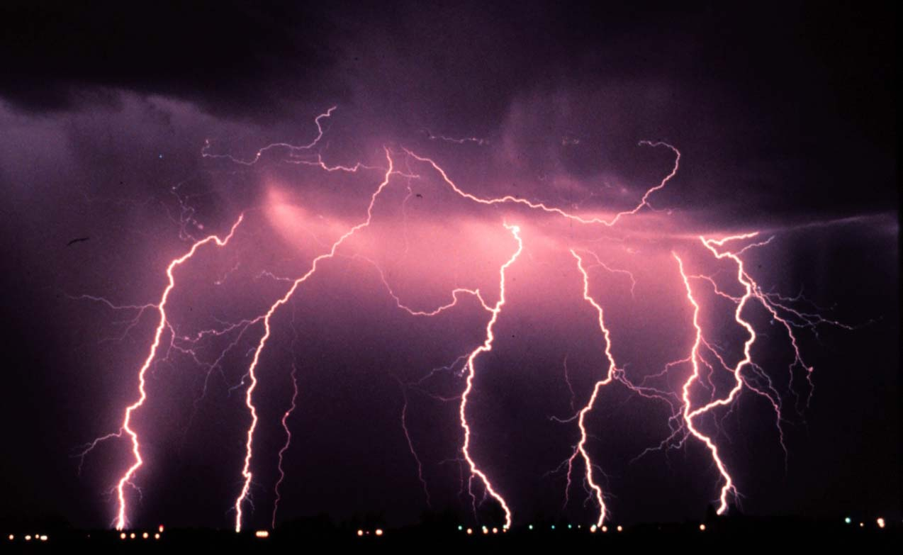
Lightning
Caused by differences in the concentration of electrons between the clouds and the ground. Lightning strikes equalize these differences.
Interesting Fact: More people are killed by lightning per year than
in tornadoes!!!
Picture taken from:
http://hibp.ecse.rpi.edu/~connor/education/Surge/
images/lightning.jpg

Slide 12
Tropical Cyclones (Hurricanes)
Large rotating masses of low pressure
Strong winds, torrential rain
Classified by maximum sustained wind speed
Typhoons
Cyclones

Slide 13
Hurricane Origins
Low pressure cell
Winds feed water vapor – latent heat of condensation
Air rises, low pressure deepens
Storm develops
  Winds less than 61 km/hour (38 miles/hour) – tropical depression
  Winds 61–120 km/hour (38–74 miles/hour) – tropical storm
  Winds above 120 km/hour (74 miles/hour) – tropical cyclone or hurricane

Slide 14
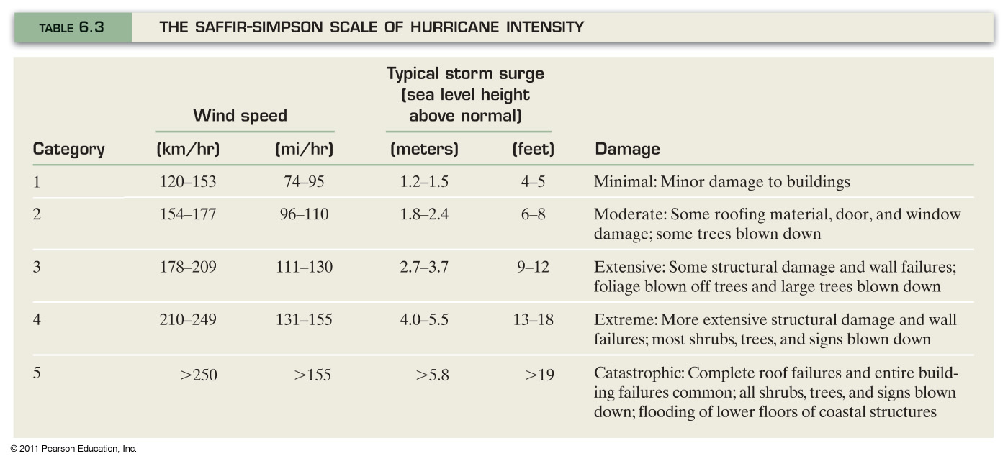
Hurricane Intensity

Slide 15
Hurricanes
About 100 worldwide per year
Require
  Ocean water warmer than° 25°C (77°F)
  Warm, moist air
  The Coriolis Effect
Hurricane season is June 1 – November 30

Slide 16
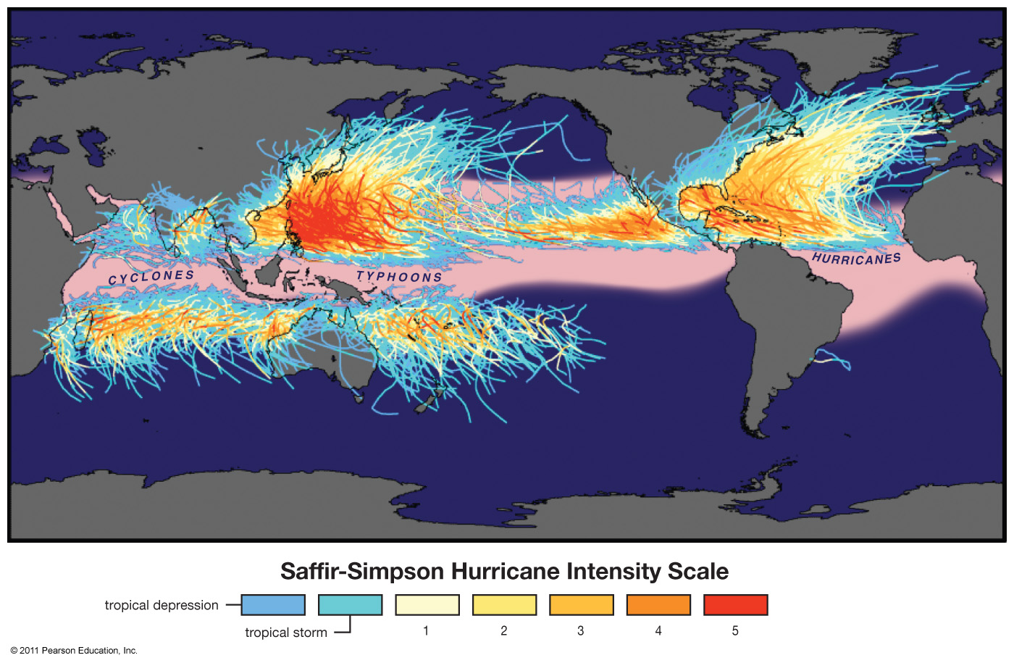
Historical Storm Tracks

Slide 17
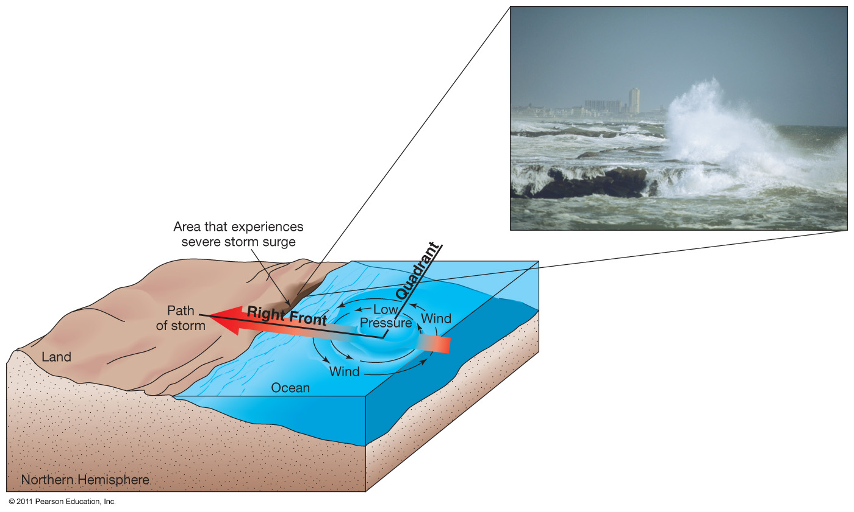
Hurricane Destruction
High winds
Intense rainfall
Storm surge – increase in shoreline sea level

Slide 18
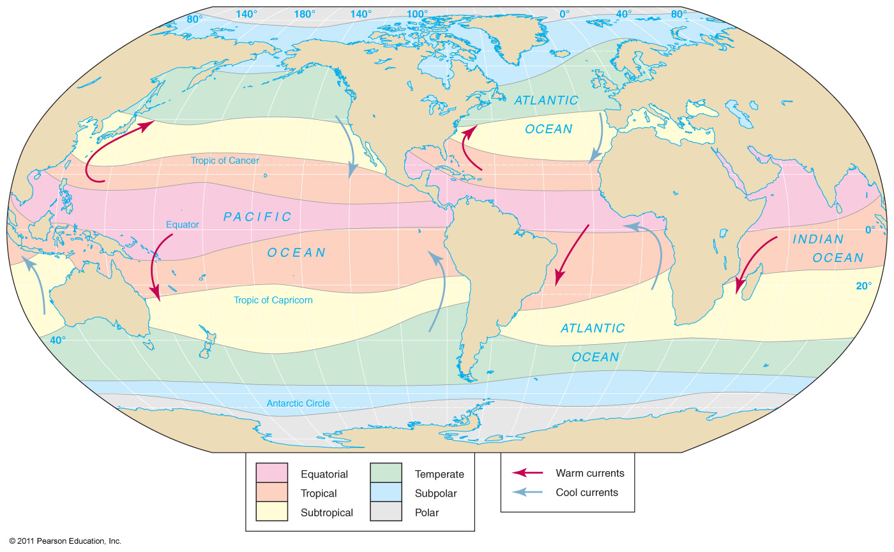
Ocean’s Climate Patterns

Slide 19
Ocean’s Climate Zones
Equatorial
  Rising air
  Weak winds
  Doldrums
Tropical
  North and south of equatorial zone
  Extend to Tropics of Cancer and Capricorn
  Strong winds, little precipitation, rough seas
Subtropical
  High pressure, descending air
  Weak winds, sluggish currents

Slide 20
Ocean’s Climate Zones
Temperate
  Strong westerly winds
  Severe storms common
Subpolar
  Extensive precipitation
  Summer sea ice
Polar
  High pressure
  Sea ice most of the year

Slide 21
Atmospheric-Ocean Connections in the Pacific Ocean
Walker Circulation Cell – normal conditions
  Air pressure across equatorial Pacific is higher in eastern Pacific
  Strong southeast trade winds
  Pacific warm pool on western side of ocean
  Thermocline deeper on western side
  Upwelling off the coast of Peru

Slide 22
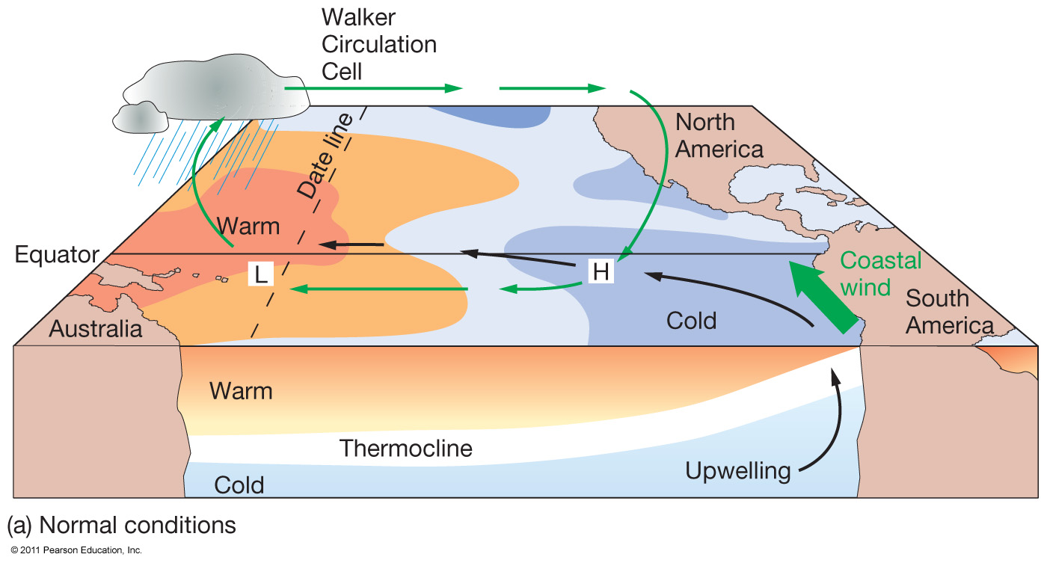
Normal Conditions, Walker Circulation

Slide 23
El Niño – Southern Oscillation (ENSO)
Walker Cell Circulation disrupted
High pressure in eastern Pacific weakens
Weaker trade winds
Warm pool migrates eastward
Thermocline deeper in eastern Pacific
Downwelling
Lower biological productivity
  Peruvian fishing suffers

Slide 24
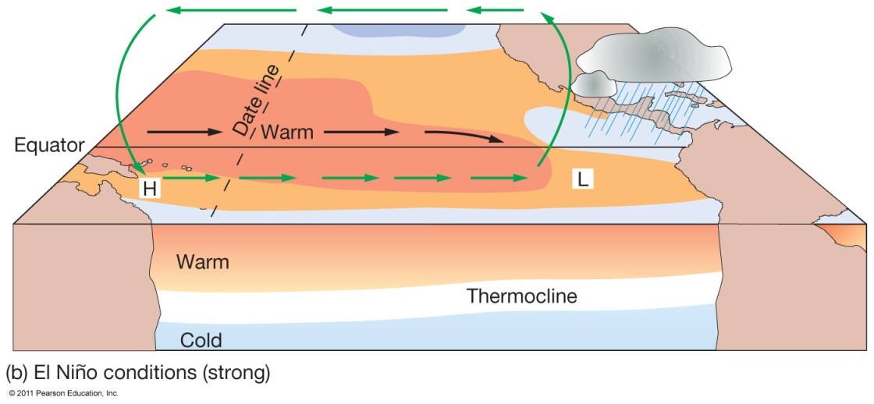
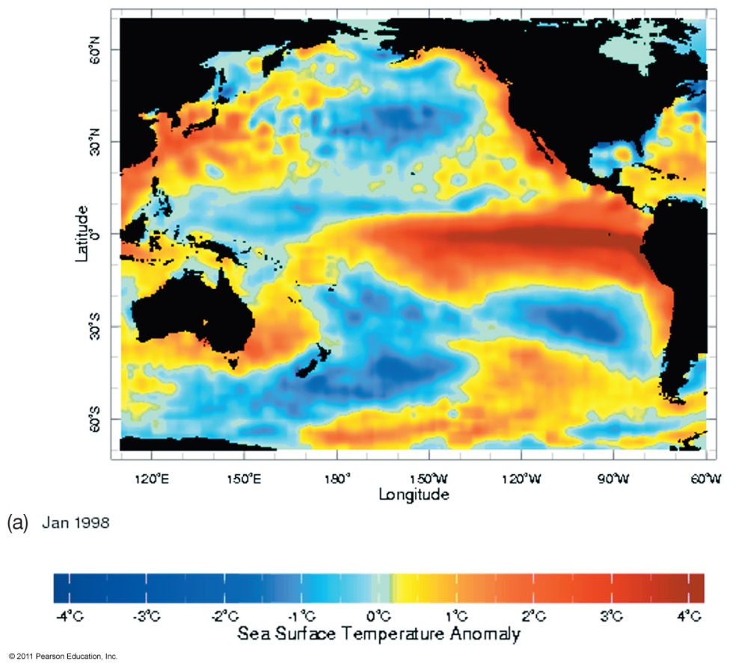
ENSO Conditions in the Pacific Ocean

Slide 25
La Niña – ENSO Cool Phase
Increased pressure difference across equatorial Pacific
Stronger trade winds
Stronger upwelling in eastern Pacific
Shallower thermocline
Cooler than normal seawater
Higher biological productivity

Slide 26
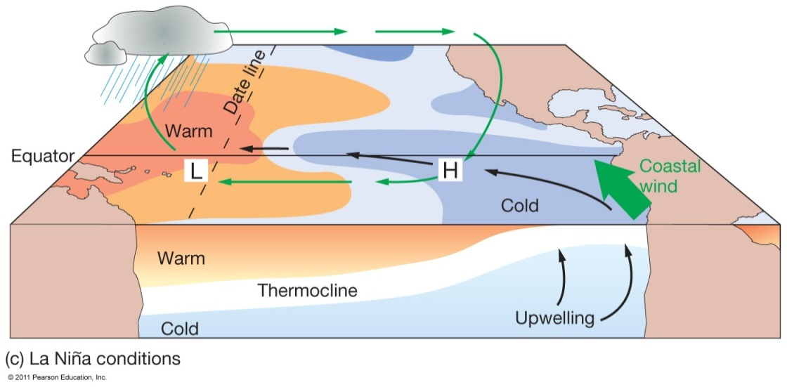
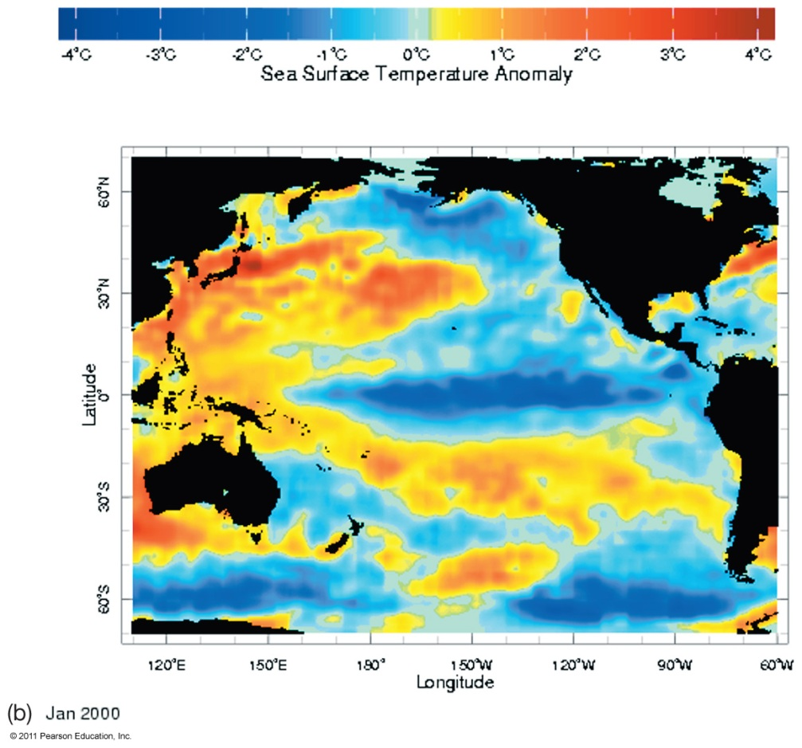
La Niña Conditions

Slide 27
Occurrence of ENSO Events
El Niño warm phase about every
2–10 years
Highly irregular
Phases usually last 12–18 months
10,000-year sediment record of events
ENSO may be part of Pacific Decadal Oscillation (PDO)
  Long-term natural climate cycle
  Lasts 20–30 years

Slide 28
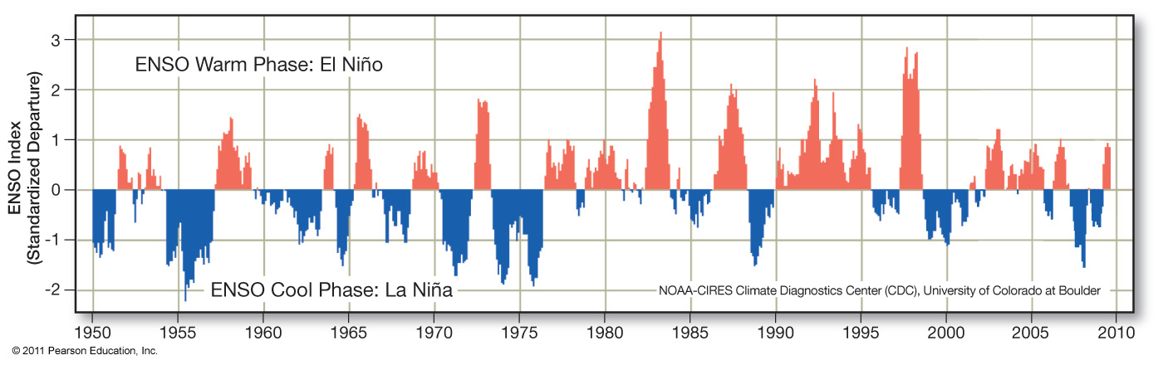
ENSO Occurrences

Slide 29
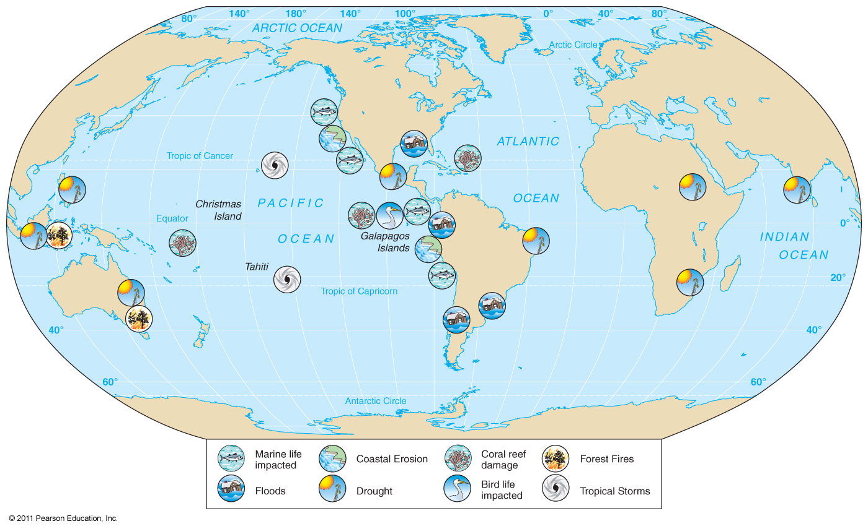
ENSO has Global Impacts

Slide 30
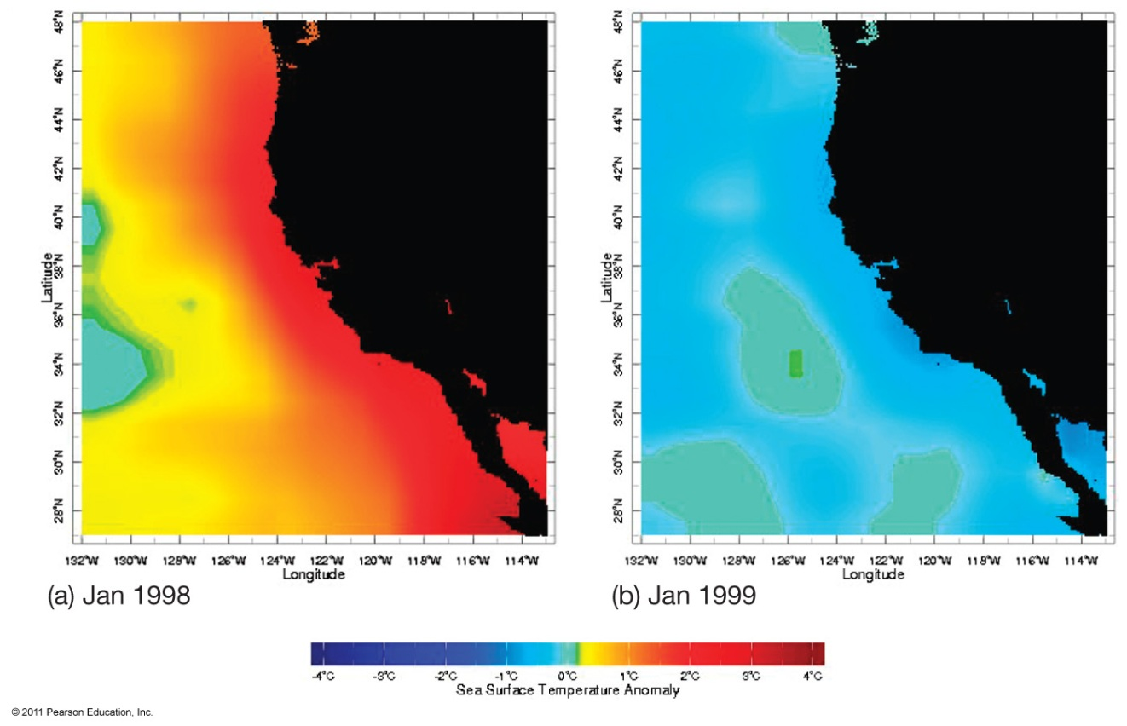
Notable ENSO Events
1982 – 1983
1997 – 1998
Flooding,
drought,
erosion, fires,
tropical storms, harmful effects
on marine life
Unpredictable

Slide 31
Predicting El Niño Events
Tropical Ocean−Global Atmosphere (TOGA) program
  1985
  Monitors equatorial South Pacific
  System of buoys
Tropical Atmosphere and Ocean (TOA) project
  Continues monitoring
ENSO still not fully understood

Slide 32
Earth’s Climate System
Climate – long term atmospheric conditions in a region
Earth’s climate includes interactions of:
  Atmosphere
  Hydrosphere
  Geosphere
  Biosphere
  Cryosphere
Climate system – exchanges of energy and moisture between these spheres

Slide 33
Earth’s Climate System
Feedback loops – modify atmospheric processes
  Positive feedback loops – enhance initial change
  Negative feedback loops – counteract initial change

Slide 34
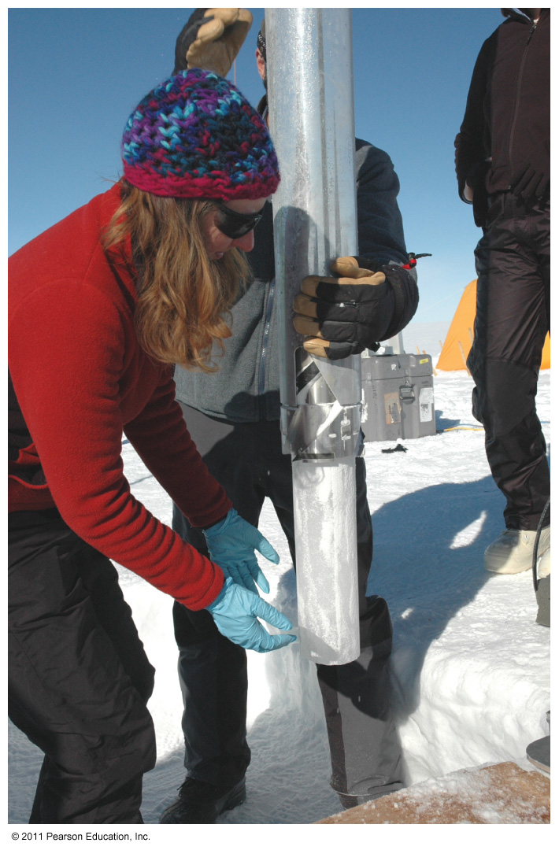
Determining Causes of Earth’s Climate Change
Paleoclimatology
Proxy data – indirect evidence using natural recorders of climate variability
  Sea floor sediments
  Coral deposits
  Glacial ice rings
  Tree rings
  Pollen
  Historical documents

Slide 35
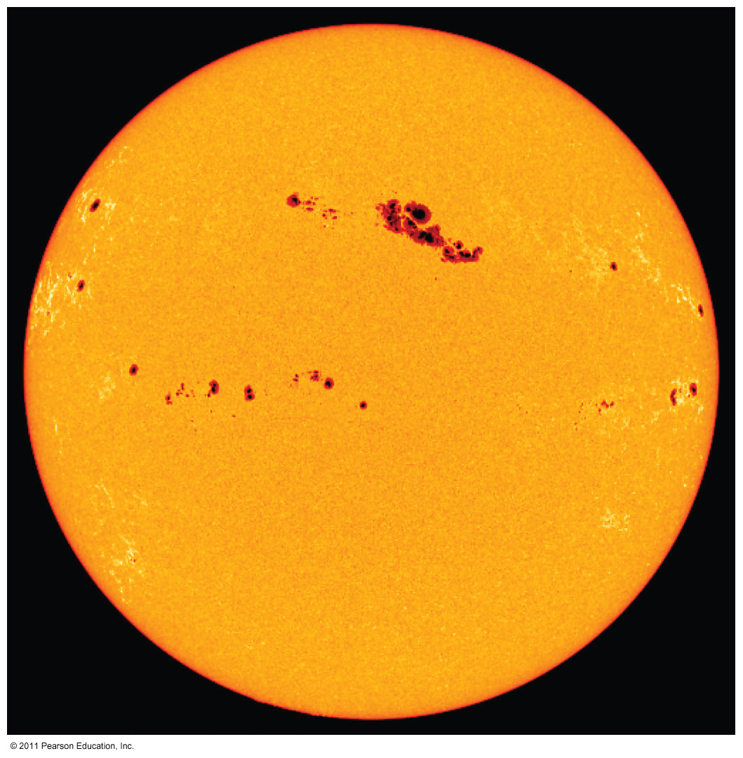
Natural Causes of Climate Change
Solar energy changes
  Variable energy from the Sun over time
  Luminosity
  Sunspots
Little evidence to link solar activity with climate change

Slide 36
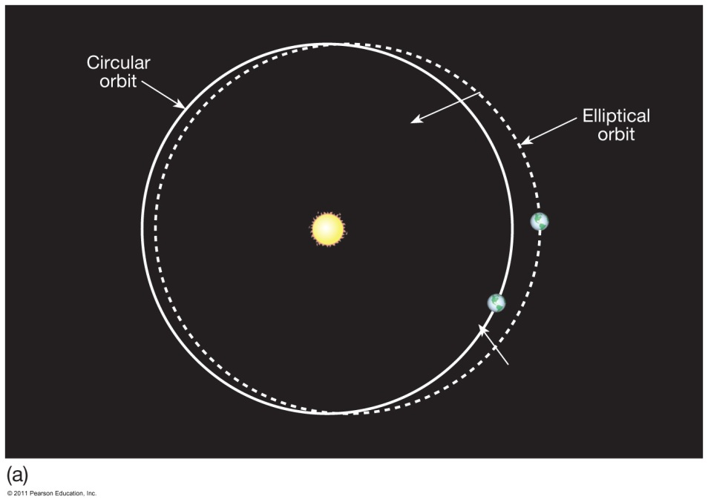
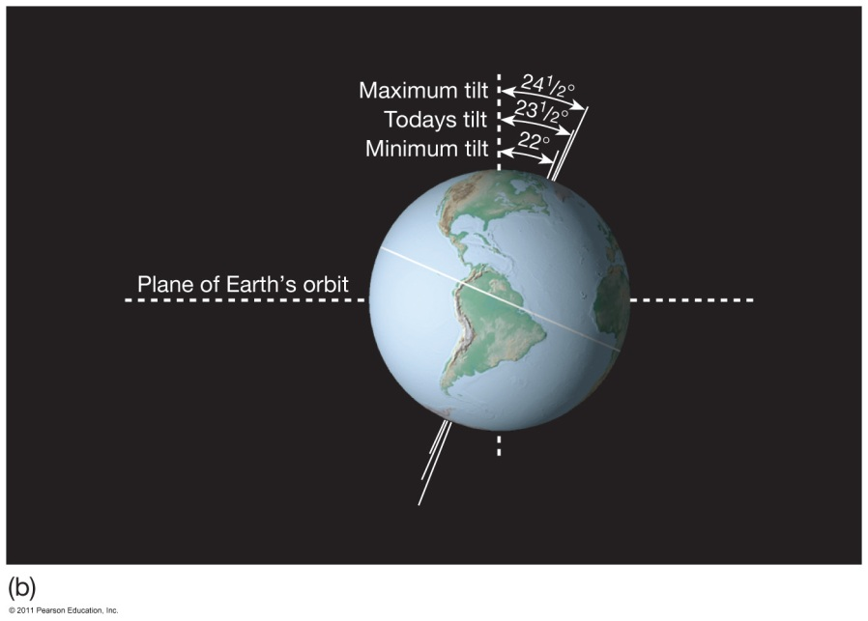
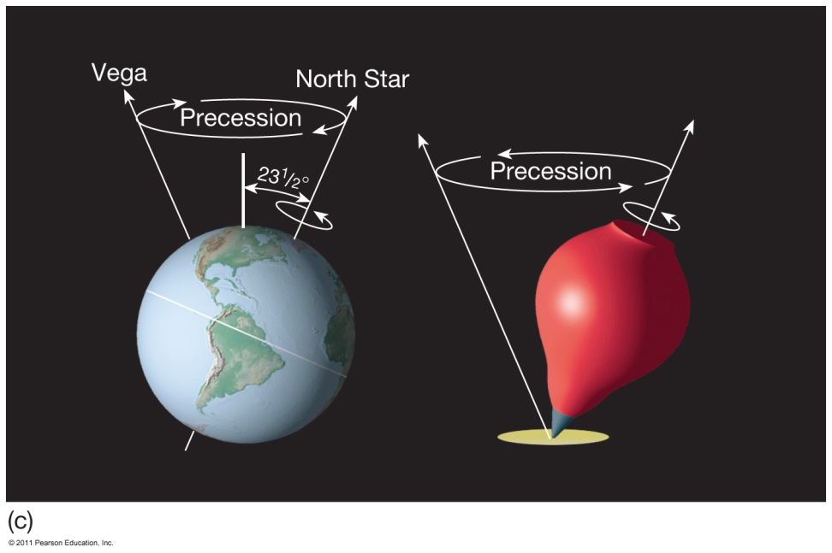
Natural Causes of Climate Change
Variations in Earth’s Orbit
Milankovitch Theories
  Eccentricity of Earth’s orbit
  Obliquity of Earth’s axis
  Precession of Earth’s axis

Slide 37
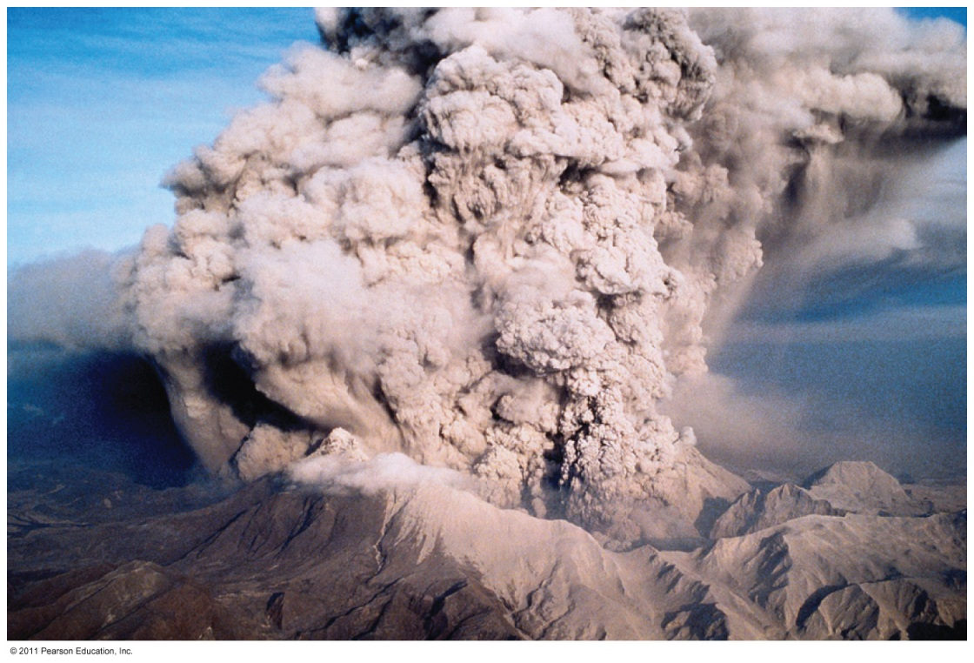
Natural Causes of Climate Change
Volcanic eruptions
Volcanic ejecta may block sunlight
Need many eruptions in short time period
Not observed in recent history

Slide 38
Natural Causes of Climate Change
Movement of Earth’s Plates
  Change ocean circulation
  Extremely slow process
  Climate change would be very gradual over millions of years

Slide 39
Natural Causes of Climate Change
The most recent cold periods are linked to what are known as the Pleistocene Ice Age, Little Ice Age, Medieval Warm Period
Recent change unprecedented
  More likely result of human activity than natural causes

Slide 40
Documenting Human-Caused Climate Change
Intergovernmental Panel on Climate Change (IPCC)
  Global group of scientists
  Published assessments since 1990
  Predict global temperature changes of
  1.4–5.8°C (2.5–10.4°F)
Climate change models can mimic modern conditions only if human emissions are taken into account.

Slide 41
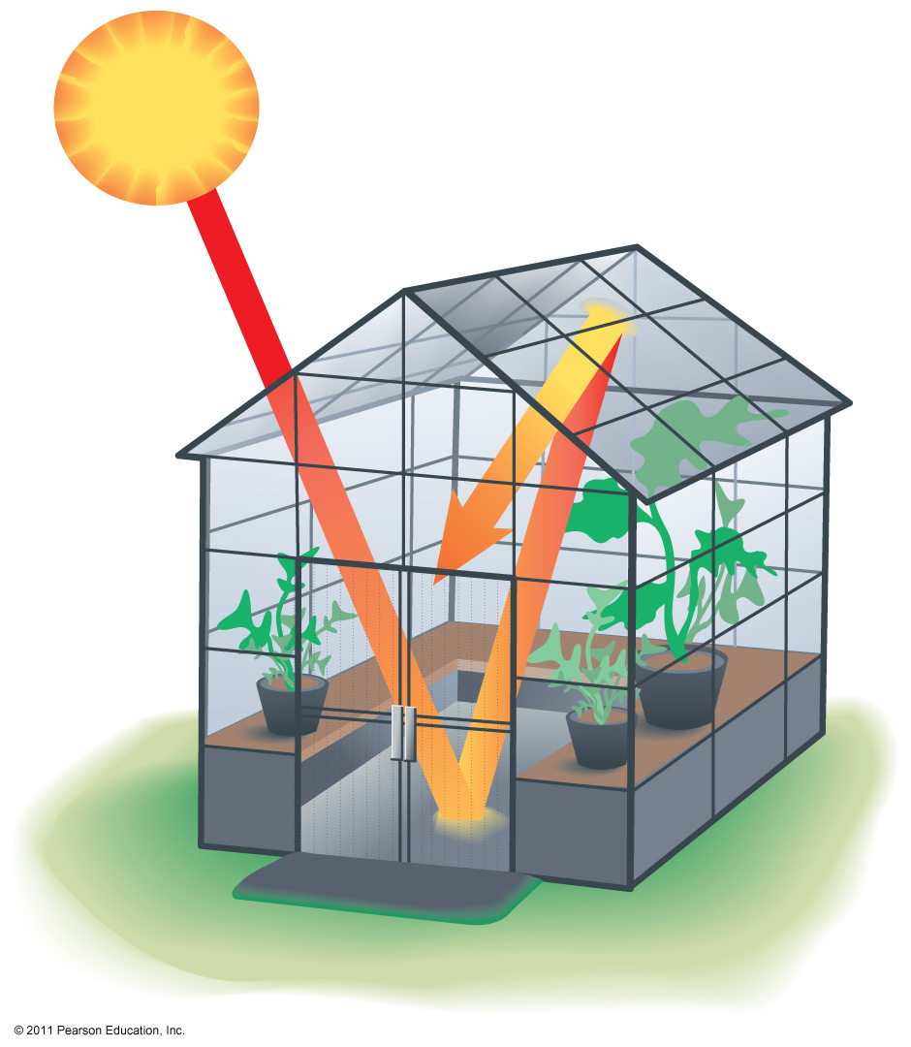
Atmosphere’s Greenhouse Effect
Global warming – increase in Earth’s global temperatures
Greenhouse effect – keeps Earth’s surface habitable
  Incoming heat energy is shorter wavelengths
  Longer wavelengths – some trapped, some escape, net warming effect

Slide 42
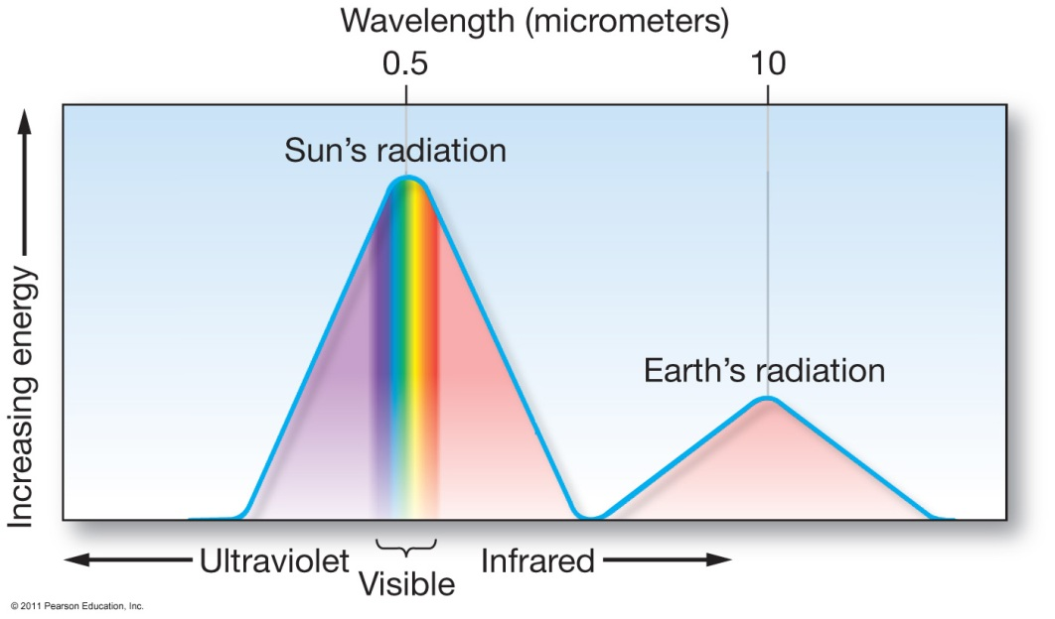
Earth’s Heat Budget
Addition to or subtraction from heat on Earth
Incoming radiation from Sun shorter wavelengths
Outgoing radiation from Earth longer wavelengths
Rates of energy absorption and reradiation must be equal

Slide 43
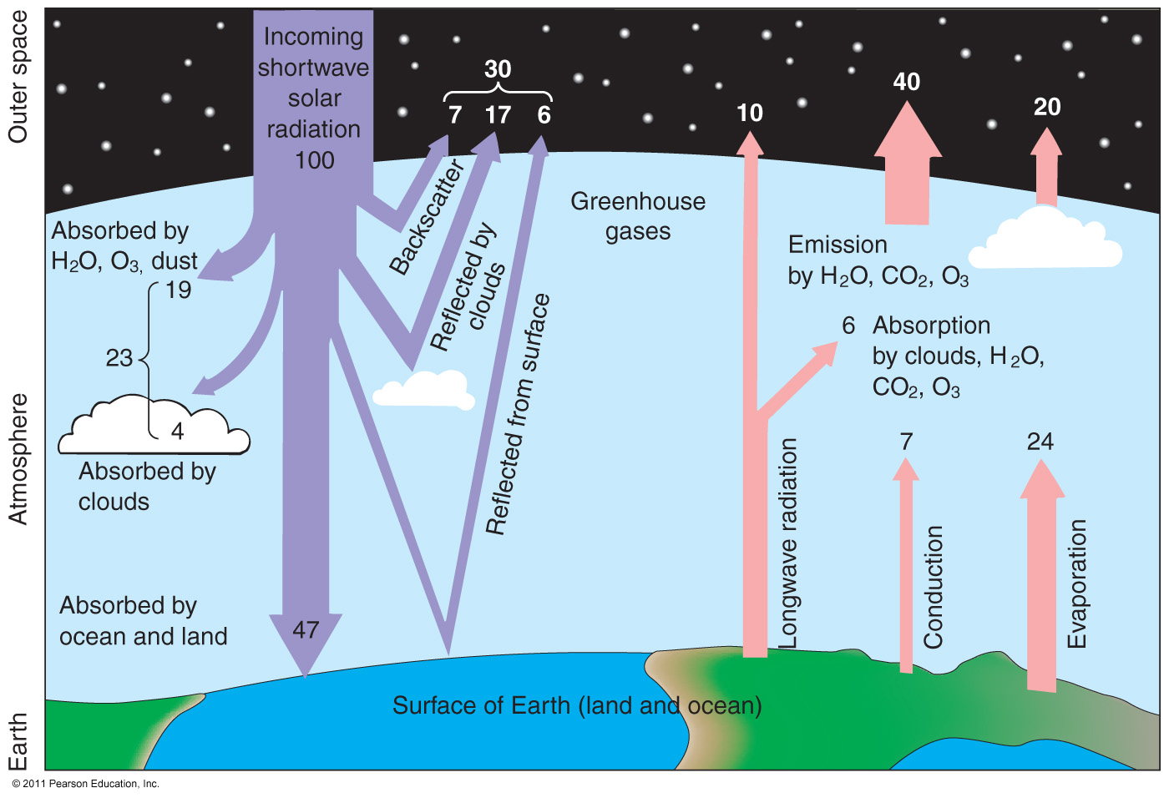
Earth’s Heat Budget

Slide 44
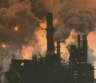
Greenhouse Gases
Greenhouse gases - carbon dioxide, methane, water vapor, nitrous oxide, and ozone/CFCs.
Are they all bad?
Retain heat through a process called the Greenhouse effect.
Picture taken from:
http://mikeytherhino.files.wordpress.com/2008/06/
greenhouse_gases.jpg

Slide 45
Greenhouse Gases
Water vapor
  Most important
  66–85% of greenhouse effect
Carbon dioxide
  Natural part of atmosphere
  Greatest relative contribution from human activities
  Burning of fossil fuels

Slide 46
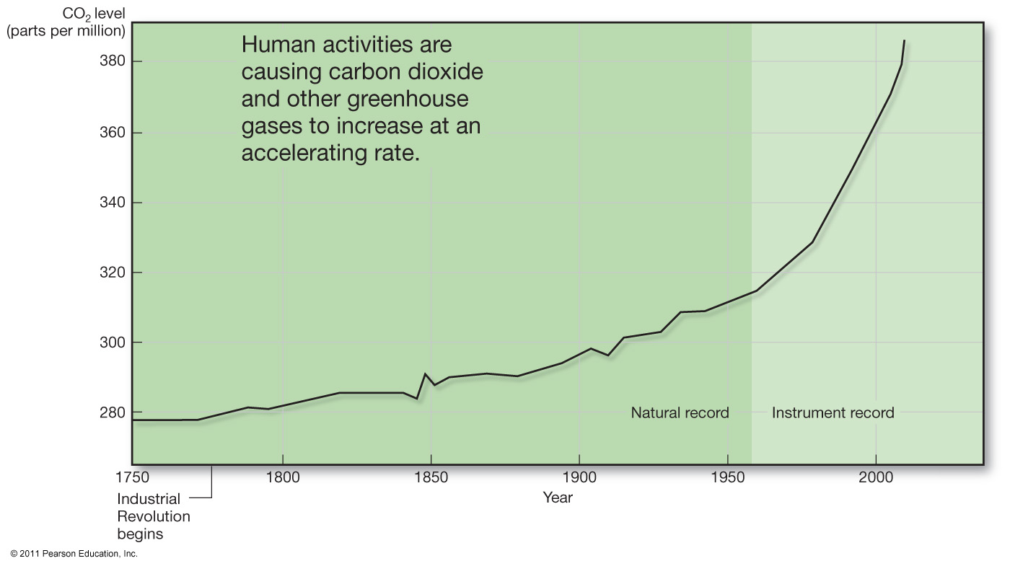
Atmospheric Carbon Dioxide

Slide 47
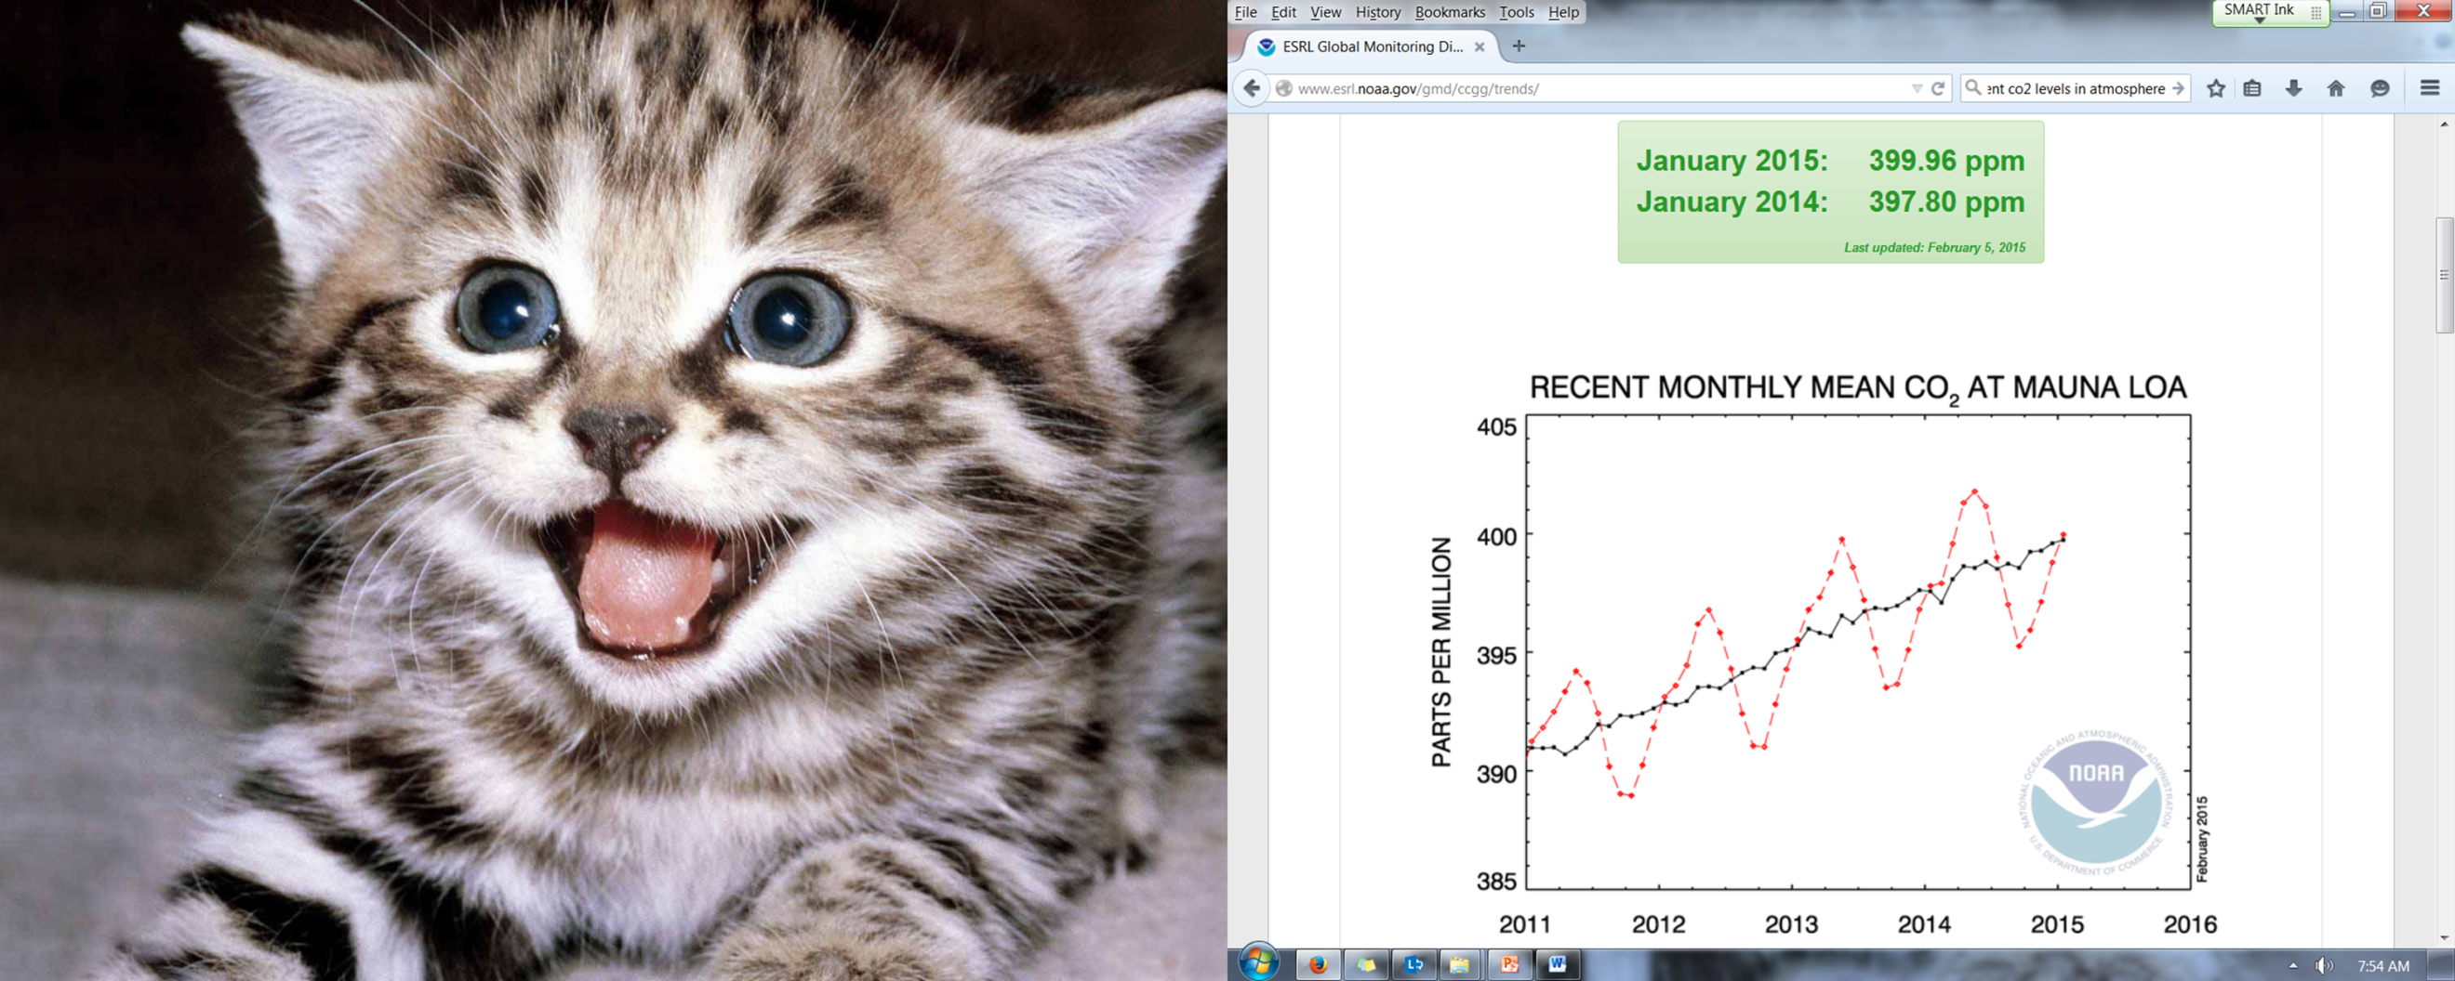

Slide 48
Greenhouse Gases
Methane
  Second most abundant human-caused greenhouse gas
  Great warming power per molecule
  Landfill decomposition
  Cattle
Other trace gases
  Nitrous oxide, CFCs, ozone

Slide 49
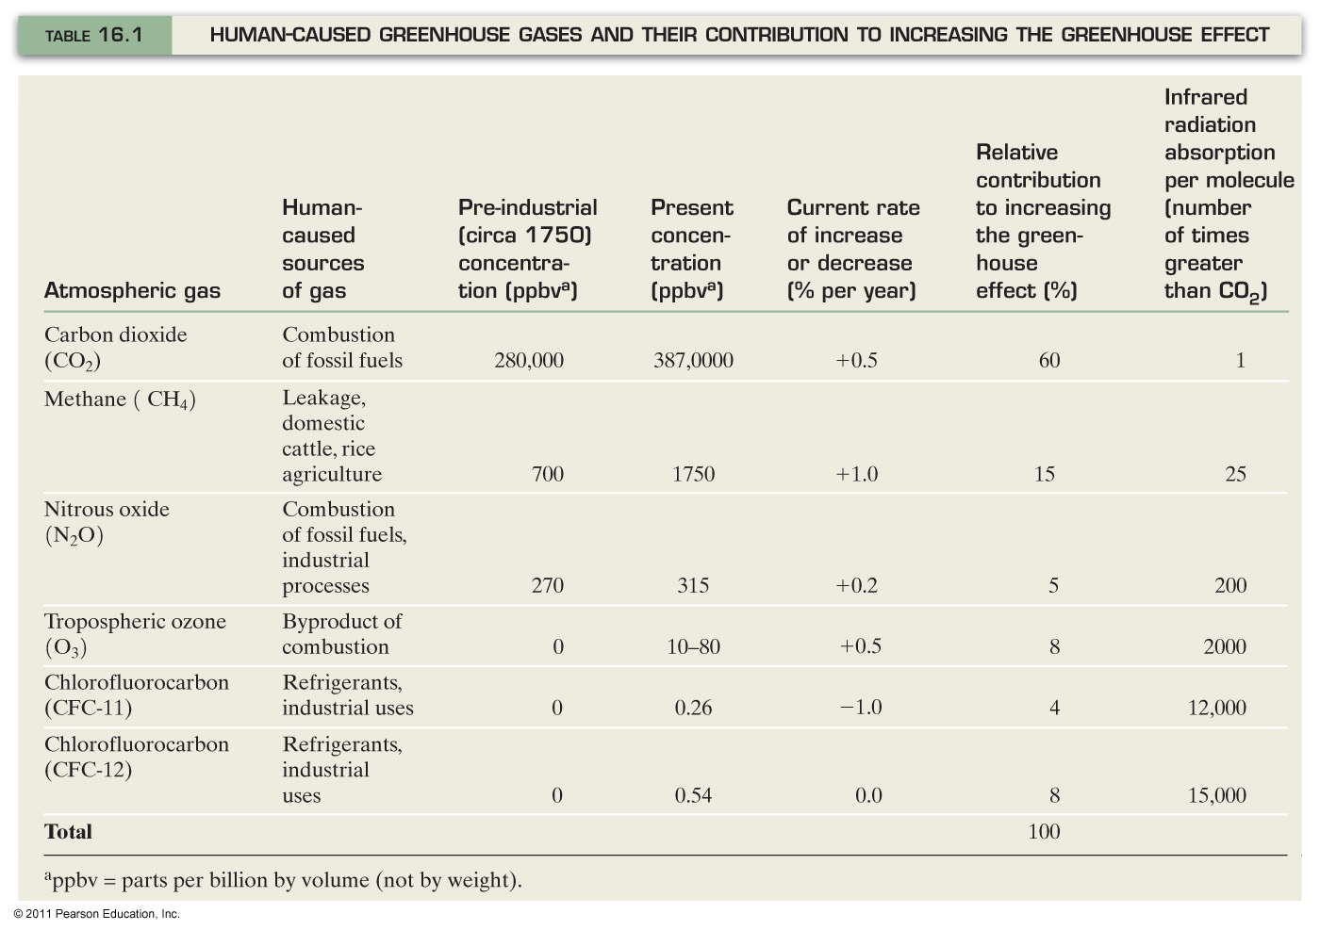
Human-Caused Greenhouse Gases

Slide 50
Albedo
Albedo is a term describing how reflective a surface is
It is given as a decimal between 0 and 1 (0 would not reflect any light, 1 would reflect all light)
Earth’s albedo is currently accepted as .31
Could humans change the Earth’s albedo? (Discuss feedback loops)

